Slide 1
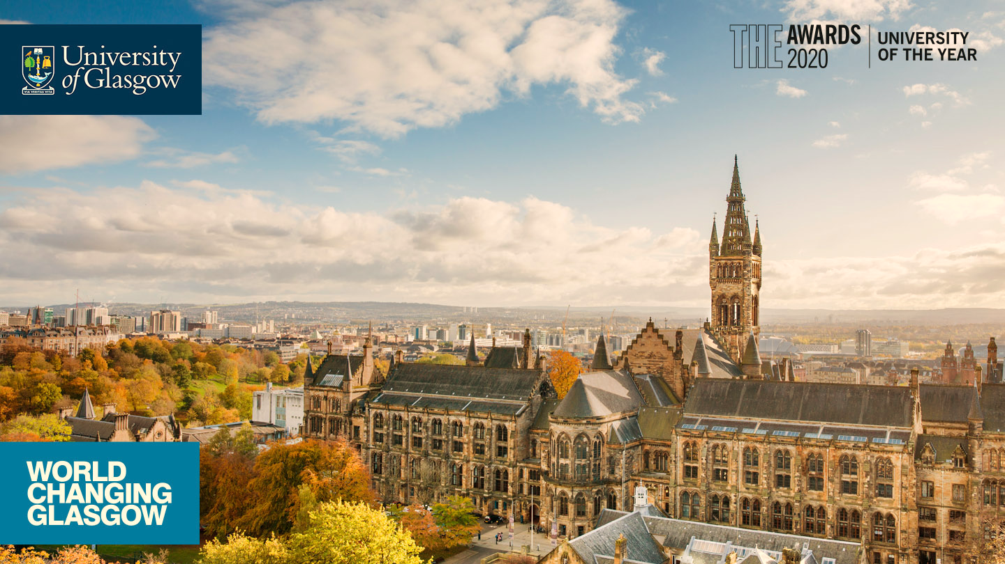

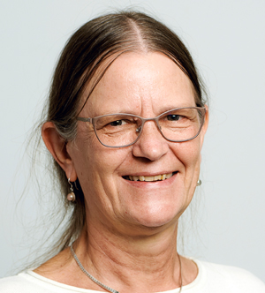

Sustainability in Learning &
Teaching Seminar Series
Title: Embedding Transformative Learning in HEIs and Adapting Quality Assurance
Speaker: Dr. Anne Zimmermann, Centre for Development and Environment, University of Bern
Abstract:
We know what the challenges of sustainable development are, we know that higher education has a key role to play in achieving the SDGs. But are higher education institutions (HEIs) ready to take the next steps and support efforts from the local to the global level to achieve the SDGs? What are these next steps, what do they imply? I will present some thoughts and questions developed during numerous conversations and projects with a committed and polymorphous community of practice whose central conviction is that HEIs can contribute to the SDGs, but they are not yet ready to do so. So what is it that they – we – need to do? To use Stephen Sterling’s words: beyond research and teaching about and for sustainable development, we need to consider research and learning as sustainability. This shift can occur if research and learning are practiced in specific ways. Students should leave our HEIs as sustainability agents and as future professionals capable of bringing everyone else on board for achieving the SDGs.
I’ll suggest what such a radical change of self-understanding implies for teaching and learning in HEIs. To start with, value consciousness is needed and the objectivity of science has to be reconceived. Next, transformative learning needs to become a “natural habit”, as suggested by the UNESCO’s 2021 Berlin Declaration. But we also need to change our teaching environment and skills, as well as our understanding of what “quality” means in HEIs – not only for teaching, but for institutions as whole entities embedded in society. Let’s see where the shoe really pinches and discuss how to address this!
Anne Zimmermann is Associated Senior Research Scientist at the Centre for Development and Environment (CDE) of the University of Bern, Switzerland. She studied various languages and literatures at various universities, then focused on multiculturalism and postcolonialism for her PhD and teaching, finally engaging with inter- and transdisciplinarity in the context of research and education for sustainable development (ESD) in the second half of her university career. As Head of CDE’s ESD cluster from 2016-2021 and President of the COPERNICUS Alliance from 2019-2021, she supported the University of Bern’s and other HEIs’ efforts to mainstream sustainable development in teaching and explored ways of implementing “sustainable education” as well as integrating transformative learning in academic contexts and enabling students to be both academics and engaged citizens. Now retired, she has started a new learning journey, among others as a Board member of Legacy17 and an active member of the ESD working group of SAGUF, which will shortly be issuing a manifesto for “Learning for Transformation”.
Date: 31/10/2022 Time: 12:00 -13:00 (GMT)
Join Zoom : https://uofglasgow.zoom.us/j/85792793998?pwd=dW9XMnc2WHNkN3Z6L0JTU1NBSW5hZz09
Meeting ID: 857 9279 3998 Passcode: 482272
Organised by: Prof. Kelum Gamage kelum.gamage@glasgow.ac.uk
Centre for Educational Development and Innovation (CEDI)
Join AdvanceHE Sustainability in Learning and Teaching network https://connect.advance-he.ac.uk/topics/23784

