Slide 1

Engaging International Students in Active Learning
Dr Julia Bohlmann
Effective Learning Adviser
For International Students

Slide 2
SESSION OUTLINE
Session Outline
Part 1
Get to know your international students
Part 2
The Interaction for Learning Framework
Notes:
My background/ Introduction
Worked as international ELA for four years
Started intercultural group work training, something that I constantly evolve based on the feedback from students
What I wanted to share with you are the cultural dimensions that resonated with the students and see whether they might give you a possible explanation for lack of engagement in class or the misinterpretation of assignments

Slide 3

Part 1 –
Get to know your international students
Experiencing the active classroom
Relationship with lecturers and tutors
Christina Page (2021) Getting to know your international students
https://kpu.pressbooks.pub/internationalstudents/

Slide 4
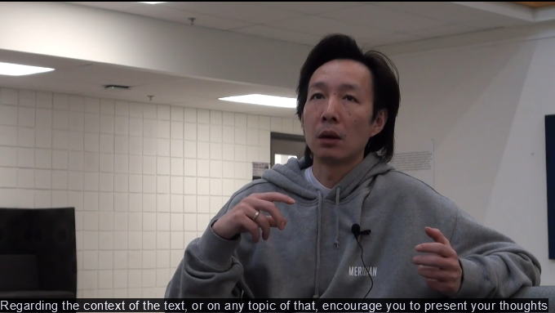
Experiencing the active classroom
What difference between the students’ previous classrooms and their new classroom seems most significant to you?
Notes:
https://kpu.pressbooks.pub/internationalstudents/chapter/classroom-experiences/

Slide 5
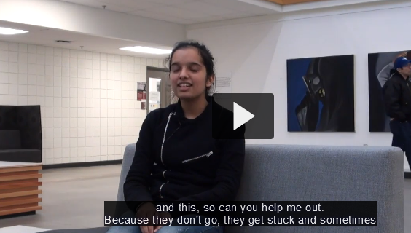
Relationship with lecturers and tutors
Break out room discussion 1
What instructor practice from the video seemed most effective to you?
How is it similar to the ways you already connect with students?
What might you add to more effectively connect with international students?
Notes:
https://kpu.pressbooks.pub/internationalstudents/chapter/relationships-with-instructors/

Slide 6
REMOVING BARRIERS AND BUILDING RAPPORT
Lee et. al. (2017) suggest some simple things you could incorporate
To improve the classroom climate and enable students to participate, they suggest a number of relatively easy rapport building activities that can be integrated at the beginning as well as throughout a course:
Learn names and attempt correct pronunciation – model this for everyone in the class.
Ask students anonymously what to them supports a feeling of being respected.
Ask your students whether they are familiar with active learning. Explain what it is and emphasise the value of active and peer interactive learning. Do this a few times throughout the course.
Incorporate time for quiet writing and organisation of thoughts before verbal discussions.
Introduce ungraded post-discussion reflections to give students a chance to feedback on whether they feel included or whether there are unaddressed needs or barriers.
Notes:
My background/ Introduction
Worked as international ELA for four years
Started intercultural group work training, something that I constantly evolve based on the feedback from students
What I wanted to share with you are the cultural dimensions that resonated with the students and see whether they might give you a possible explanation for lack of engagement in class or the misinterpretation of assignments

Slide 7

Part 2 –
The Interaction for Learning Framework
Sophie Arkoudis et. al. (2010) Finding Common Ground https://melbourne-cshe.unimelb.edu.au/__data/assets/pdf_file/0010/2297206/FindingCommonGround_web.pdf

Slide 8
The 6 Steps of the Interaction for Learning Framework
Planning interaction
Creating environments for interaction
Supporting interaction
Engaging with subject knowledge
Developing reflexive processes
Fostering communities of learners
Notes:
Core principles of the framework The Interaction for Learning Framework: › Acknowledges and capitalises on student diversity as a resource for learning and teaching; › Engages students from diverse cultural and linguistic backgrounds within the learning context in a variety of ways; › Embeds interaction in curriculum planning and links to teaching, learning and assessment; › Promotes peer engagement through curriculum-based activities; and › Recognises the variety of ways that interaction can be utilised across different learning contexts.

Slide 9

1. Intentional design: Planning interaction
Planning interaction means including peer interaction activities into the learning design
draw upon student diversity to develop subject knowledge and skills
Assessment as purposeful trigger for interaction between students from different backgrounds
Examples:
Problem-based learning in groups
Team-based learning around constructed peer-groups
(Arkoudis et al. 2010 p. 11)
Notes:
Intentional learning design
Without intention students stay within their own peer groups
Familiar reference system – comfort

Slide 10
2. Setting the Scene: Creating environments for interaction
strategies to increase student participation
ideally used during the first weeks of classes to ‘set the scene’ and develop students’ confidence in interacting with other students
provide opportunities for students to (safely) move out of their cultural comfort zones
Examples:
Icebreakers
Short peer-learning activity at beginning of each class (5min)
Mixing up groups (number system)
(Arkoudis et al. 2010 p. 13)
Notes:
Here interaction btwn diff groups need to be incorporated to increase confidence and set the scene early
This doesn’t have to be a classroom discussion or better:
Think about the classroom discussion as the final activity
Active learning needs to be scaffolded
For instance, start with anonymous poll or mentimeter activity
Then pair students up (not the person next to them)
Create groups of 4 – to select one speaker to report to the whole class
Finally classroom discussion

Slide 11
3. Supporting interaction
Inform students about the expectations and benefits of working in groups and across cultures
set up the ground rules and expectations for learning tasks
Making connections to Intended Learning Outcomes and Graduate Attributes
Explaining active learning conventions, for instance the courtesy of asking questions as a way of initiating discussion
Book an SLD session dedicated to group work skills: Julia.Bohlmann@glasgow.ac.uk
Provide resources to support effective group work and Staying Connected

Slide 12

4. Engaging with subject knowledge
use linguistic and cultural diversity to co-construct subject knowledge:
Skills
Learning strategies
Cultural experiences
Examples:
draw on diverse perspectives on an issue through case studies or discussions
project work and problem solving skills
group project with knowledge from different culture as core component
(Arkoudis et al. 2010 p. 16-18)

Slide 13
5. Developing reflexive processes
Using the knowledge base available in the classroom
Encouraging higher levels of interaction i.e. using what students have learned in the course in:
Peer feedback
Reflection on learning
Examples:
Checklist or scoring sheet for peer feedback
Reflective questions or written tasks (learning journals, forums)
(Arkoudis et al. 2010 p. 18-19)

Slide 14
6. Fostering communities of learners
Moves beyond the classroom, into independent learning activities
Can the learners use diversity as a resource for independent learning?
Examples:
Online collaborations (blogs, wikis)
Peer mentoring schemes
(Arkoudis et al. 2010 p. 20)

Slide 15

Individual reflection
& break out room discussions 2
Which of these activities do you think you could trial in your course?
How would you go about it?
How would you know it is successful?
Notes:
5-min reflection then debrief and discussion – depending on size of the workshop, could also be a mentimeter or padlet activity….

Slide 16
References & Resources
Arkoudis, S. et al. (2010). Finding Common Ground: Enhancing Interaction between Domestic and International Students. Australian Learning & Teaching Council, 2010.
Lee, A. et al. (2017). Teaching Interculturally: A Framework for Integrating Disciplinary Knowledge and Intercultural Development. Stylus Publishing, LLC. http://ebookcentral.proquest.com/lib/gla/detail.action?docID=4983583
Page, C. (2021). Foundations of Intercultural Teaching. Kwantlen Polytechnic University. https://kpu.pressbooks.pub/foundationsofinterculturalteaching/
Name pronouncing tools:
https://www.howtopronounce.com/names/index.php
https://www.nameshouts.com/
Group Work Moodles:
Effective Group Work: https://moodle.gla.ac.uk/course/view.php?id=6451
Staying Connected: https://moodle.gla.ac.uk/course/view.php?id=24258

