Slide 1



An Inclusive exploration of CAD/CAM: A Staff/Student Partnership that aims to integrate the Digital Workflow into the Curriculum
Mr Stephen Dunn, Mr Harry Wheeler & Mr Robert McKerlie

Slide 2
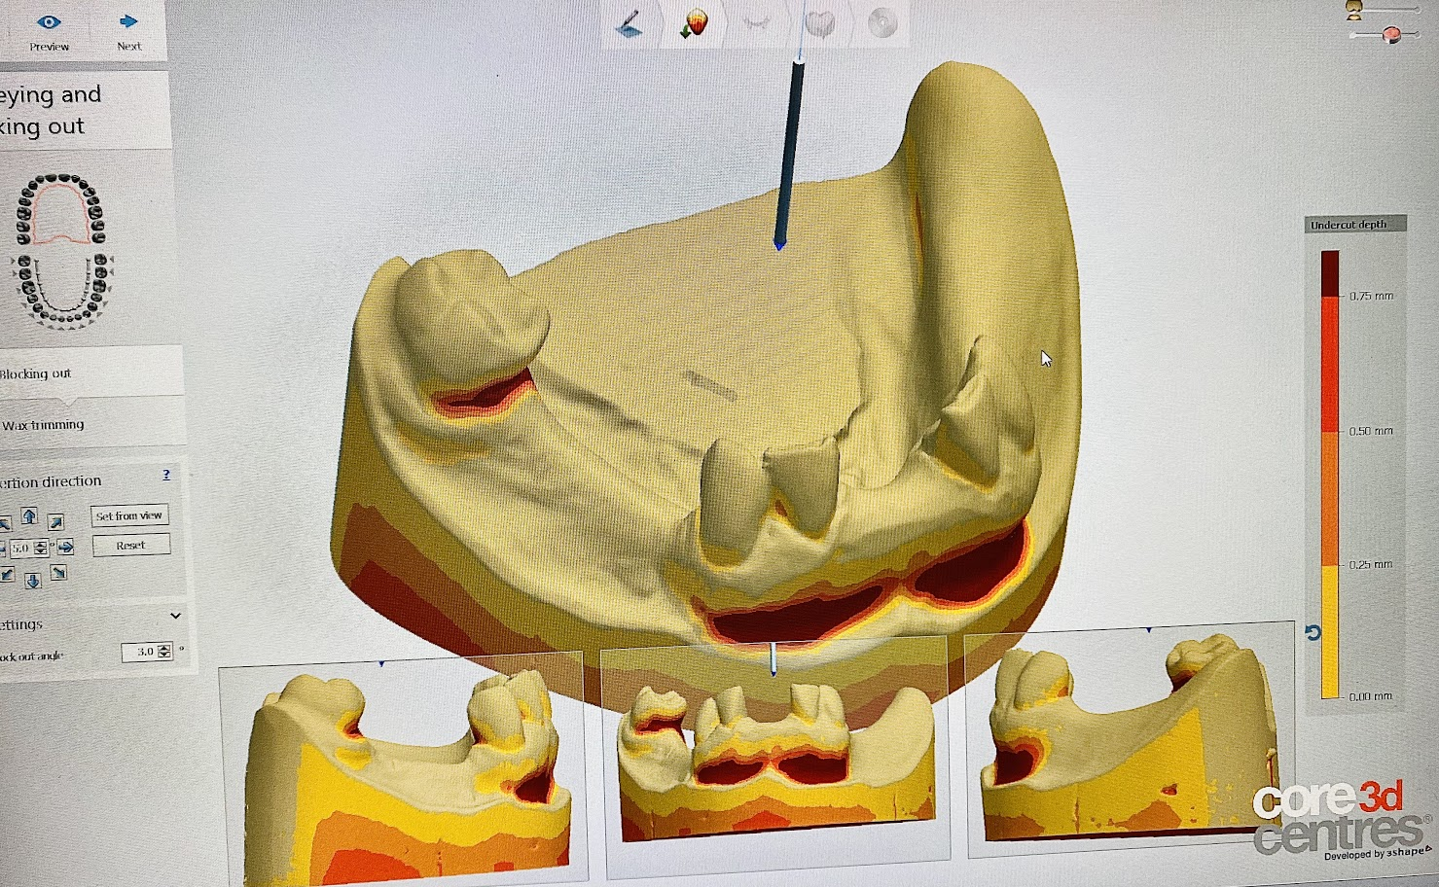
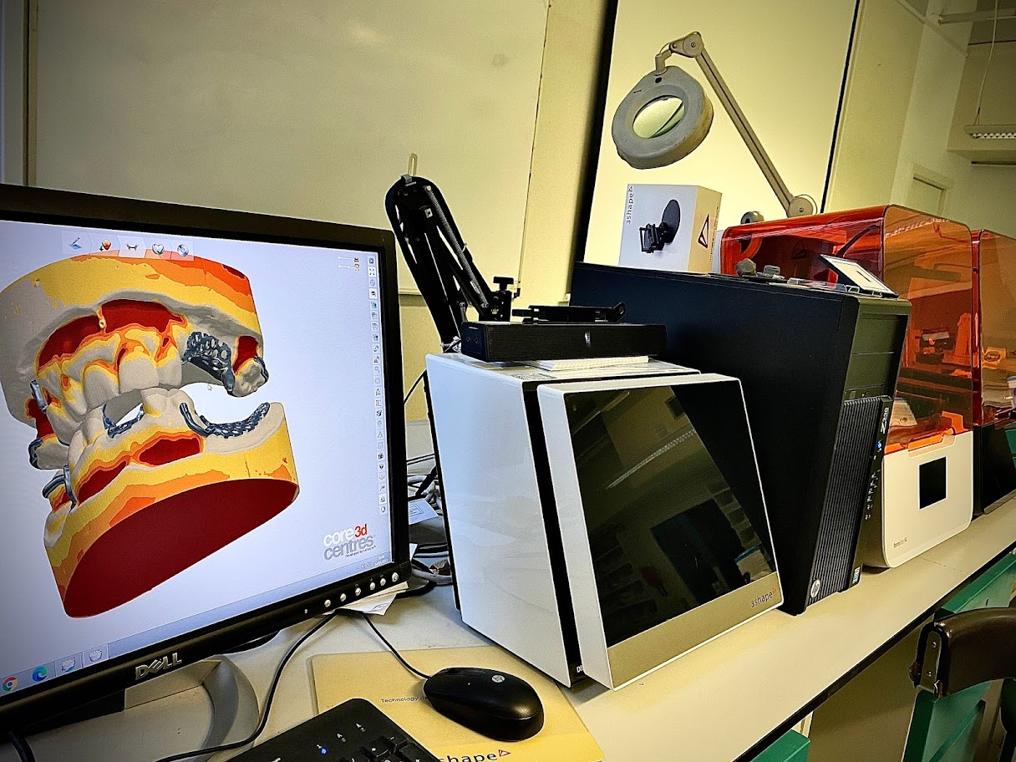
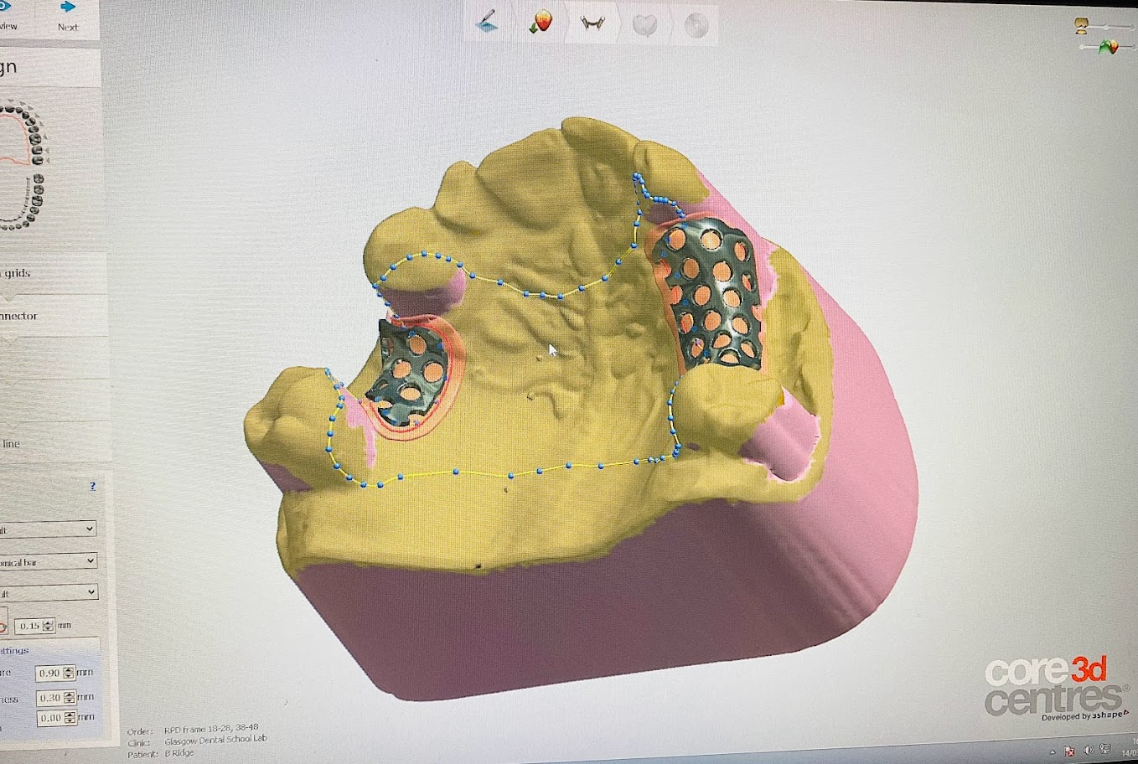
Pre-Clinical Skills Prosthodontic CAD/CAM Suite
Notes:
50/50
Tell the story of how this partnership all came together

Slide 3

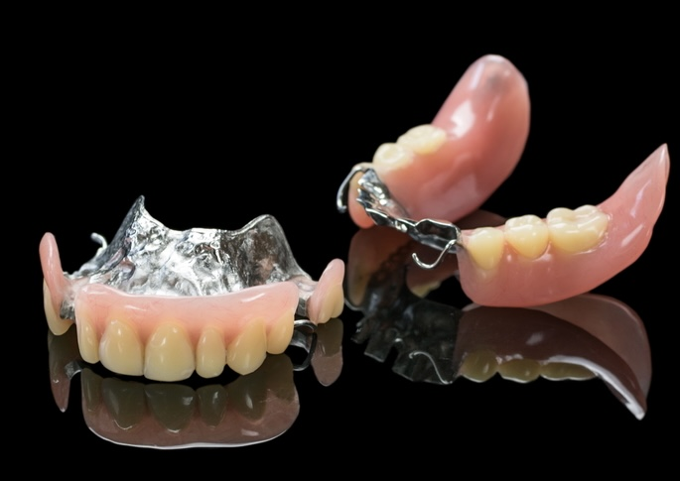
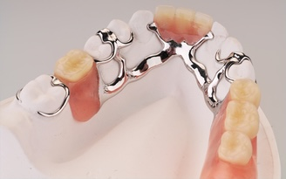
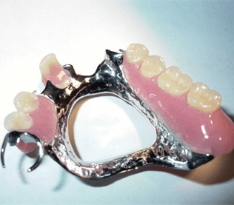
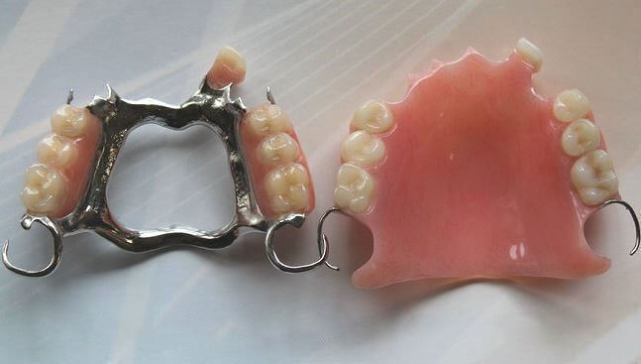
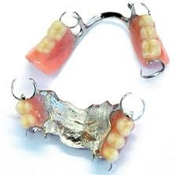
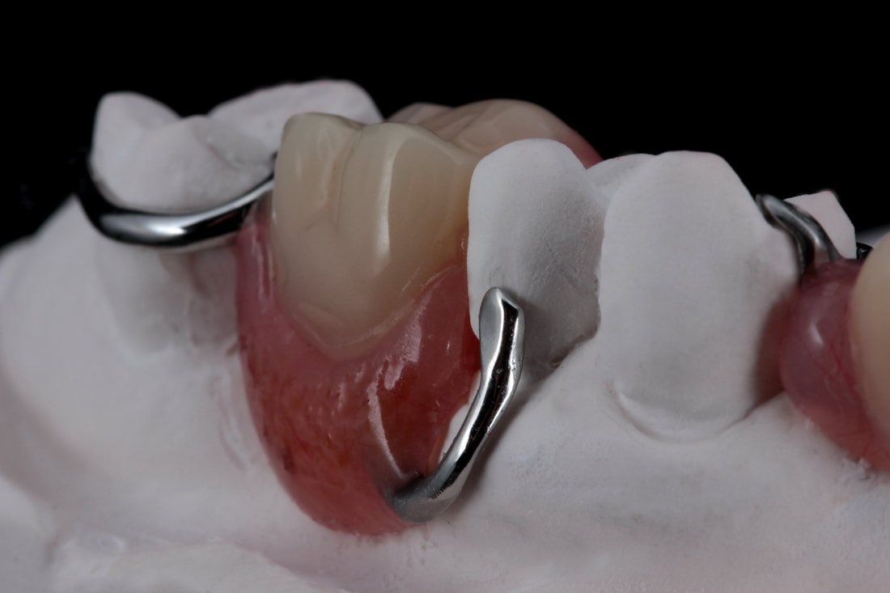
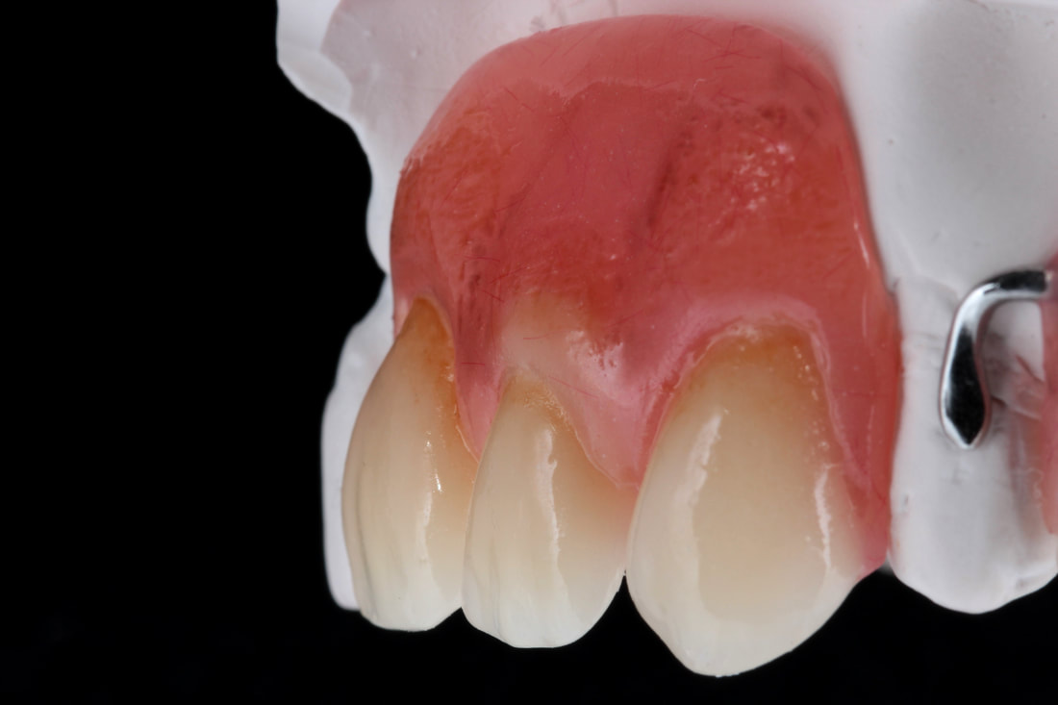
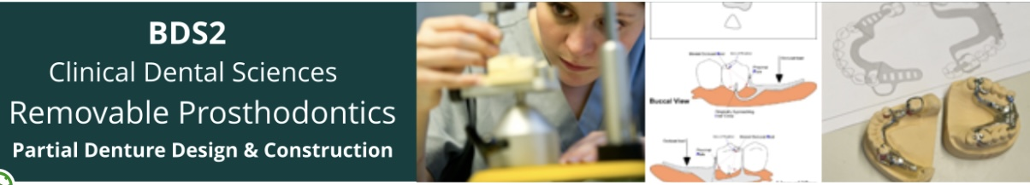

Notes:
50/50
How its important to clinical dentists and students

Slide 4

Loch et al. (2020) reveals that there is an Increased global demand for Removable Partial Dentures.
“Removable partial dentures (RPDs) remain a widely used treatment option to restore function in partially edentulous patients In the current practice” Almufleh et al. (2020).
“For some many years it has been recognised that a fundamental problem exists among the dental profession when prescribing, designing, and fabricating removable partial dentures” Lynch et al. (2007).
Notes:
Stephen Slides – Clinical Research

Slide 5


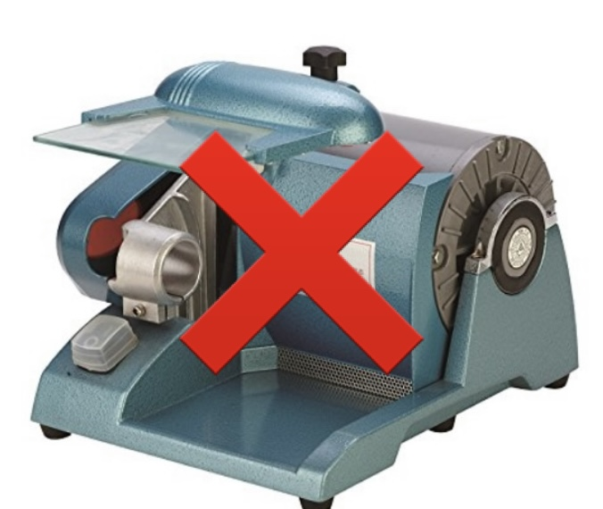
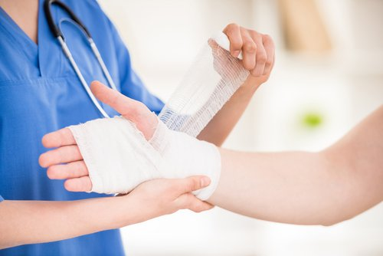
Notes:
Stephen slides
Health and safety

Slide 6
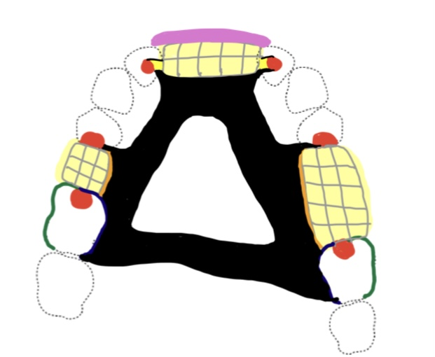
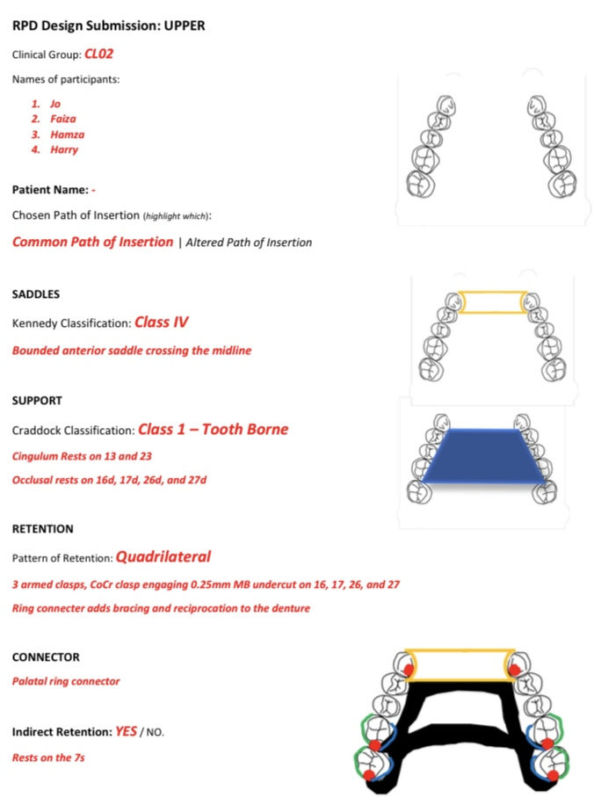
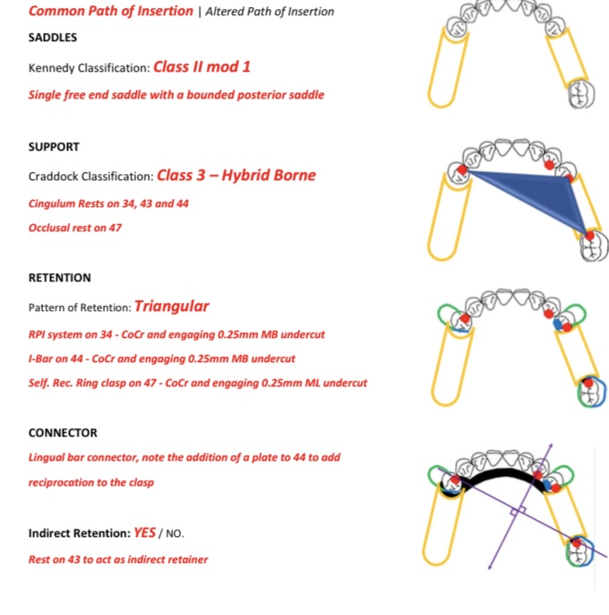
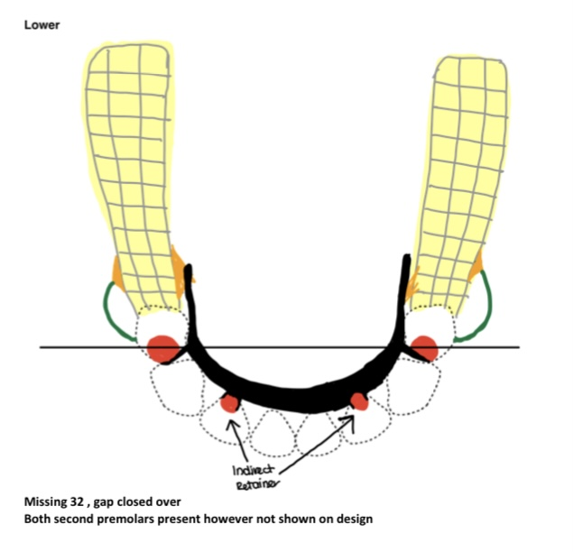
Notes:
Harry
This is how we present our work etc
Visually it’s a bit challenging, as it doesn’t look anything like a denture etc
How I feel about the course

Slide 7
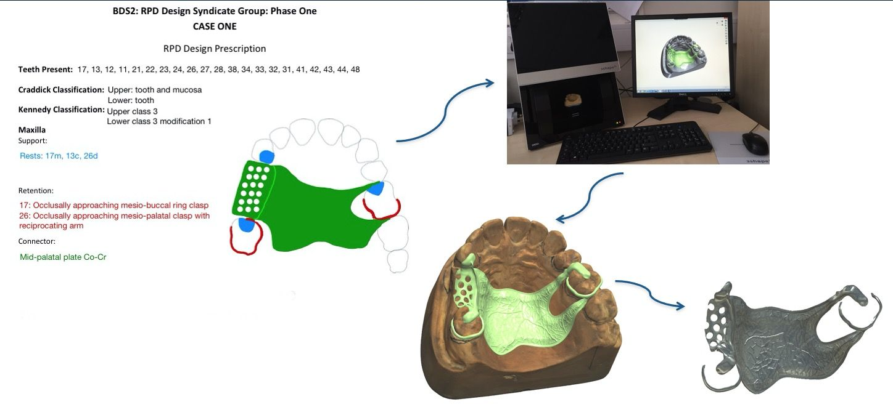
From two dimensional design to three dimensional modelling
Notes:
Harry
how its better than conventional

Slide 8
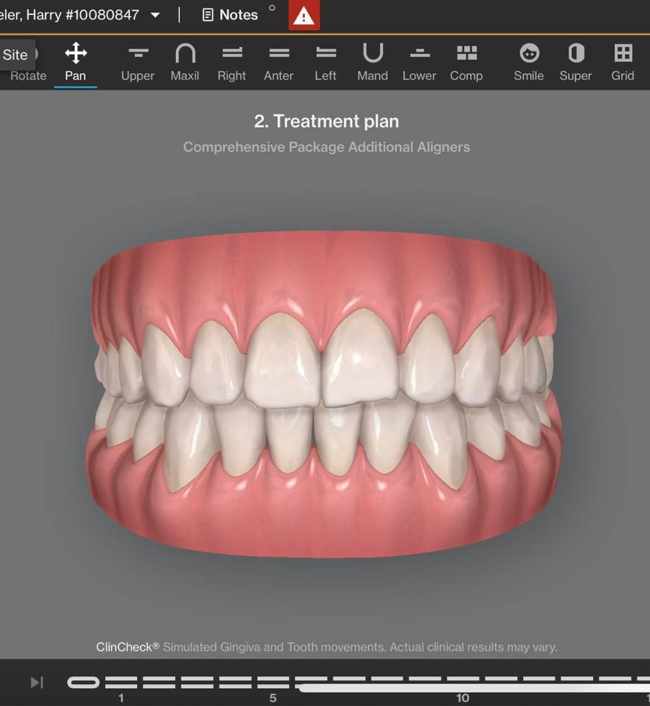
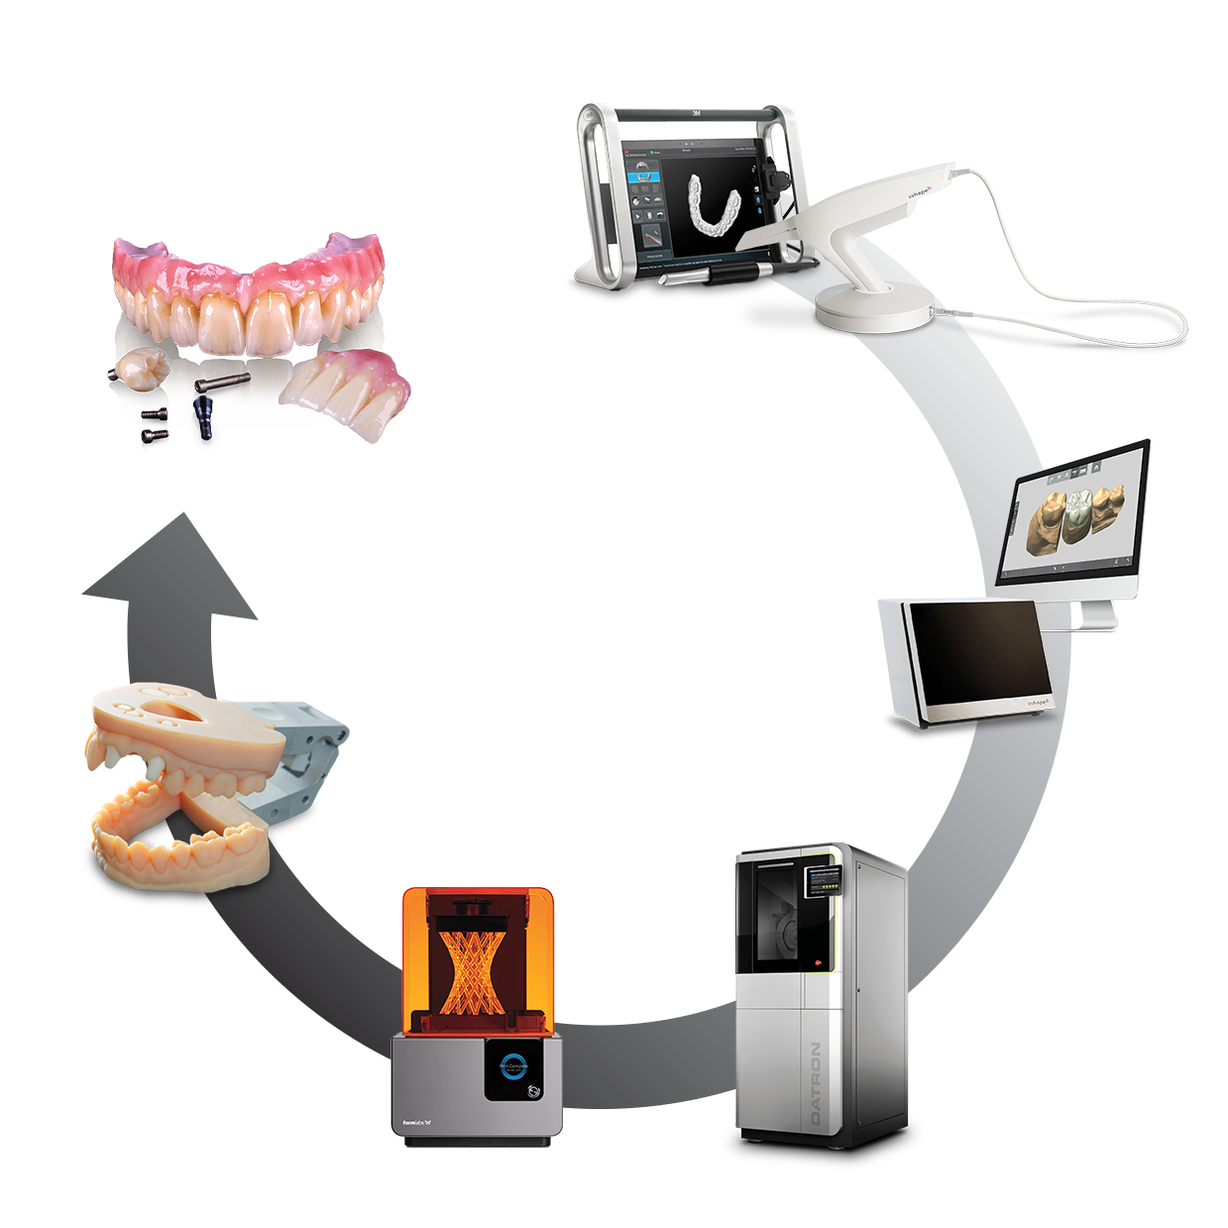
Notes:
Harry
Digital Dentistry

Slide 9
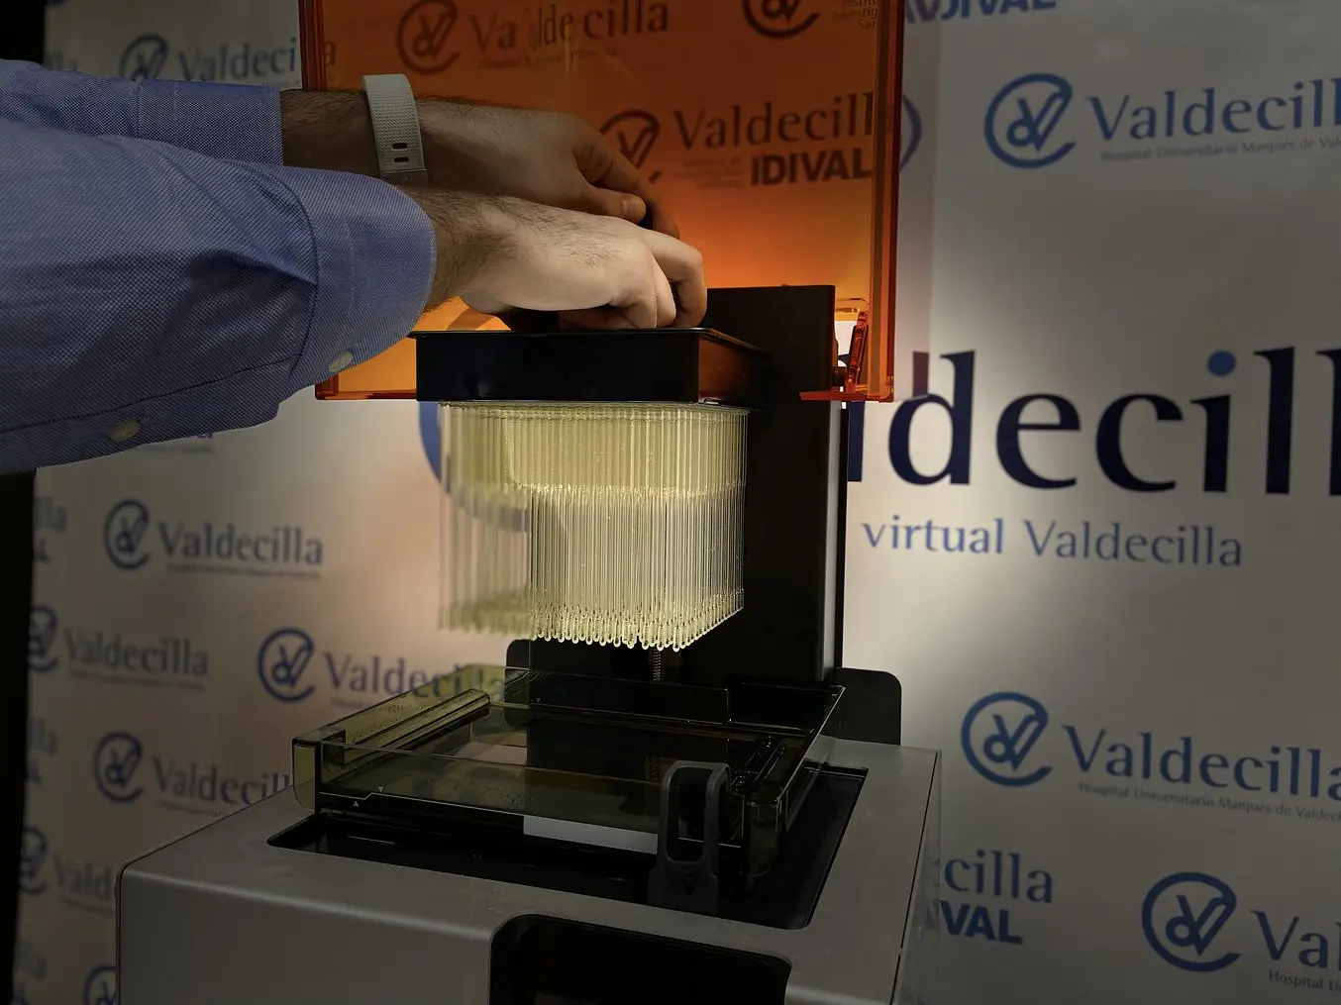
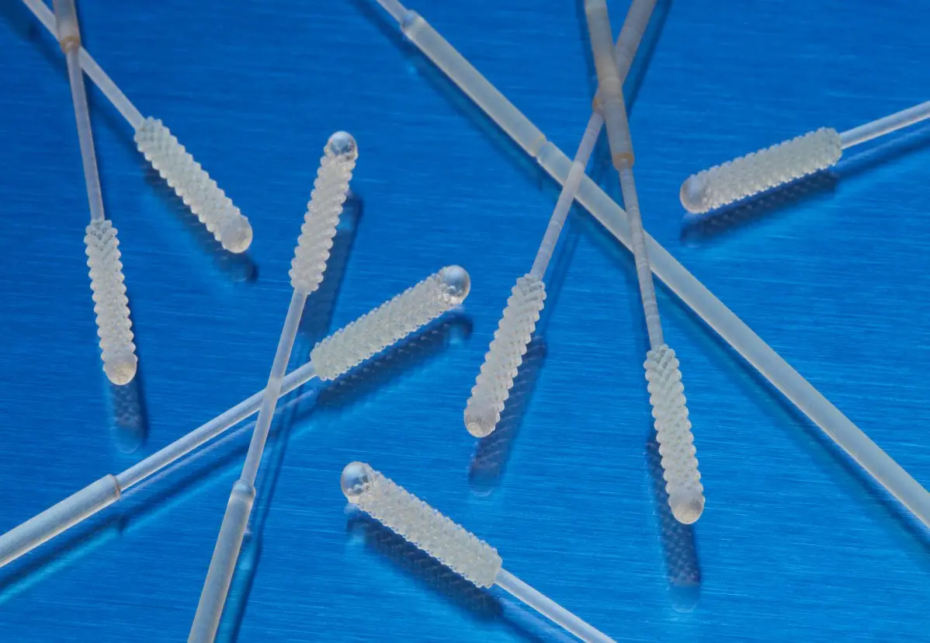
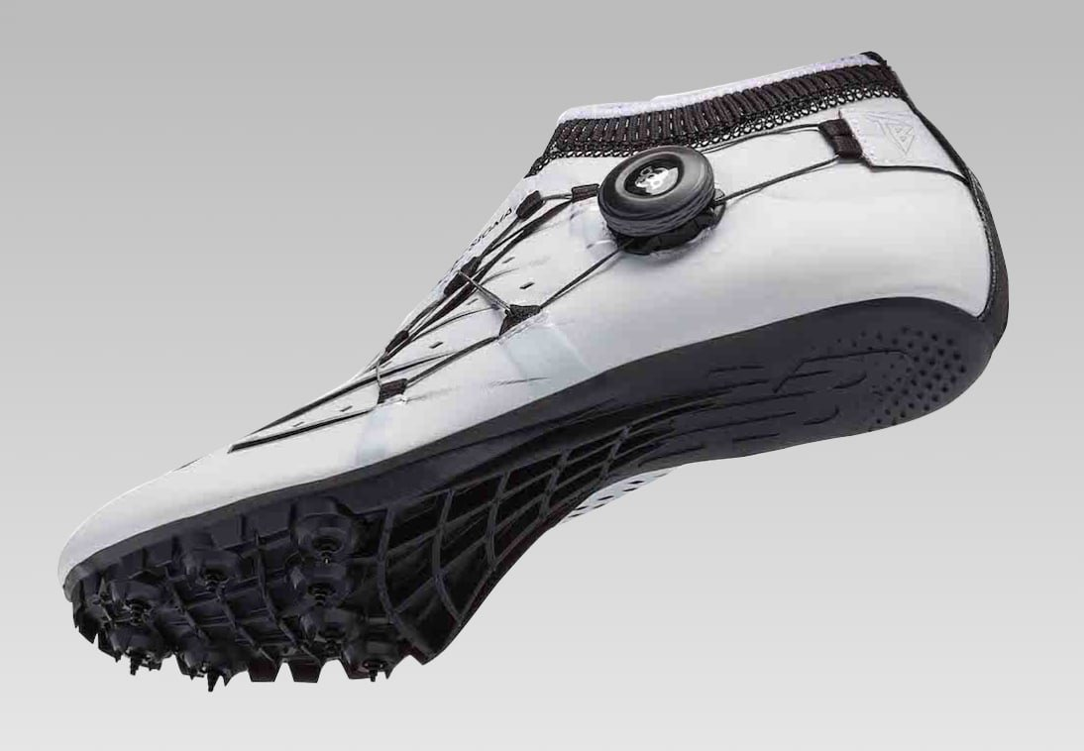
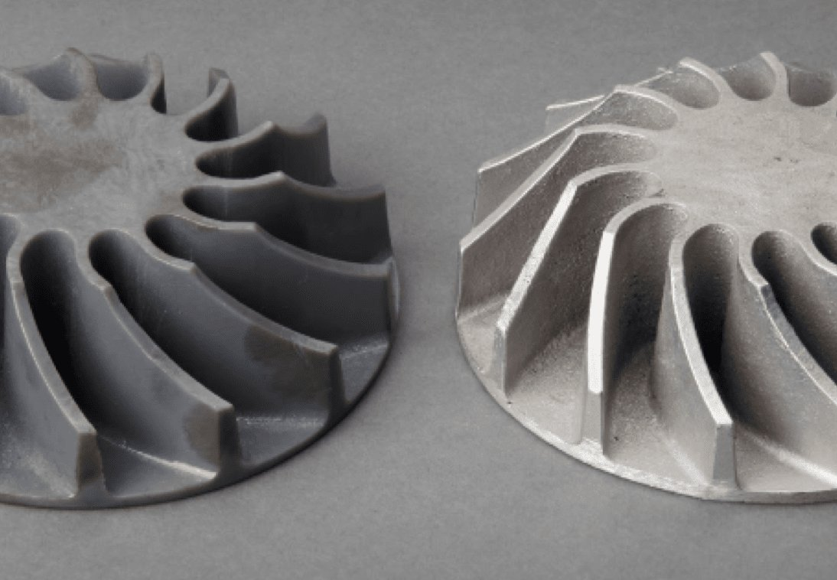

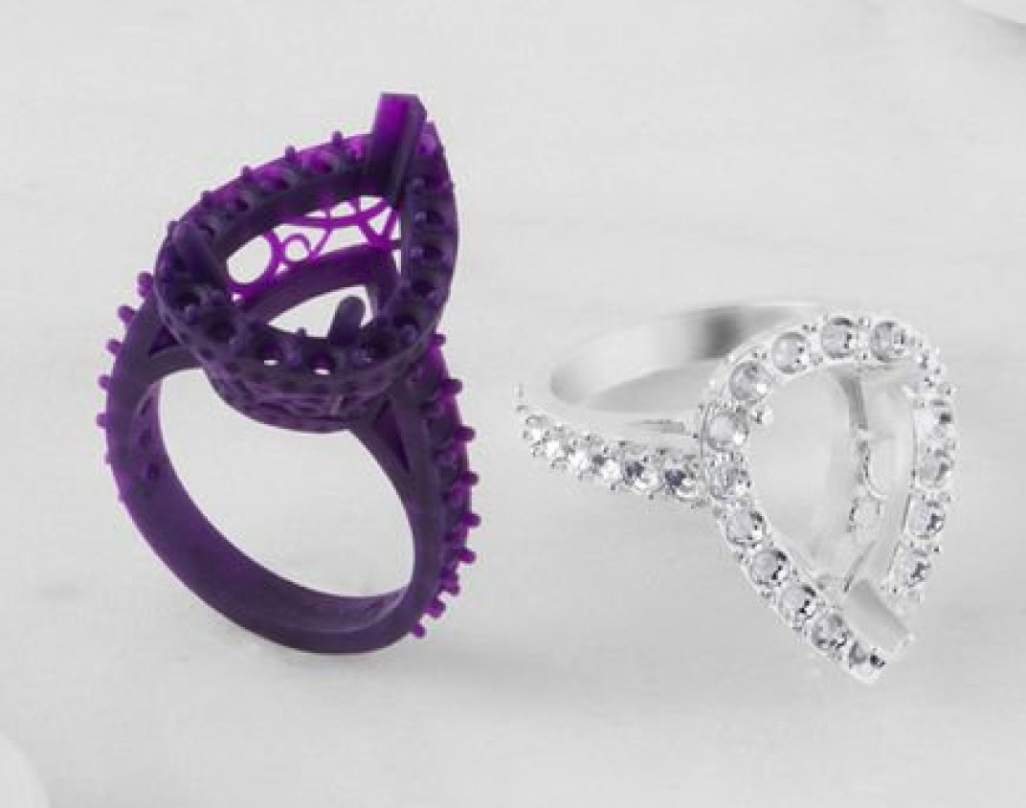
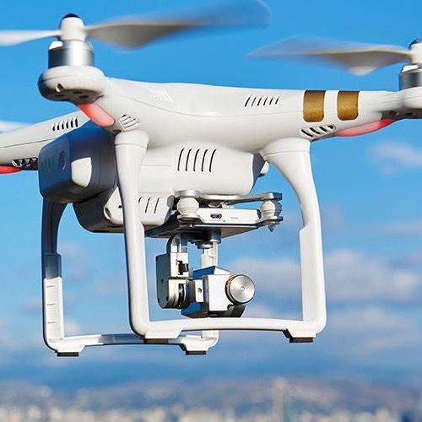
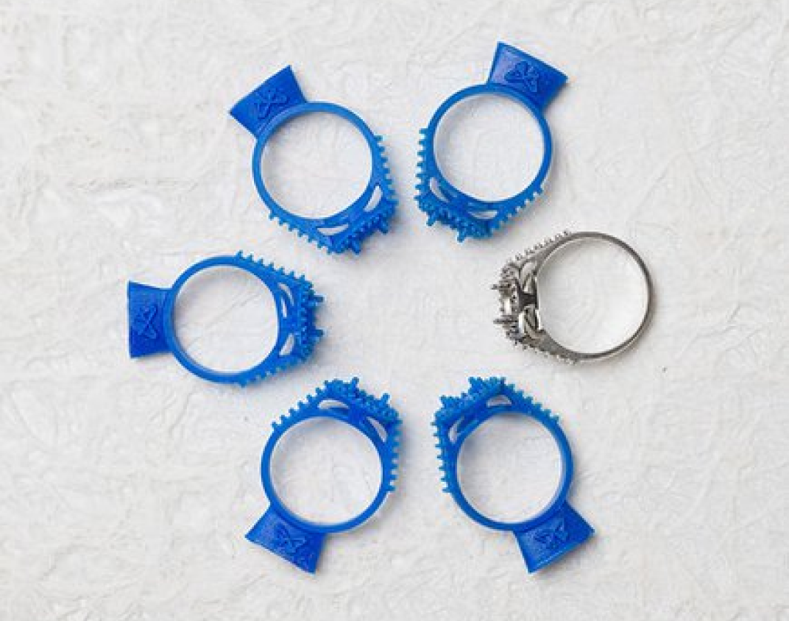
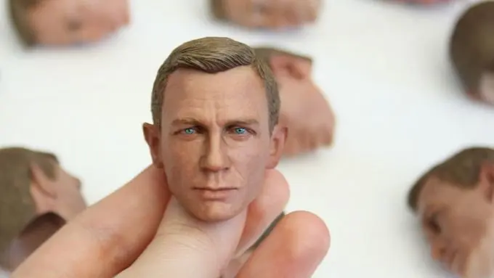
“3D printing has moved beyond the early
adopter phase, but still shows signs of
robust growth and expansion into new
industries and applications”
The 2022 3D Printing Applications Report, Formlabs.
Notes:
Stephen
CAD CAM and 3D printing

Slide 10
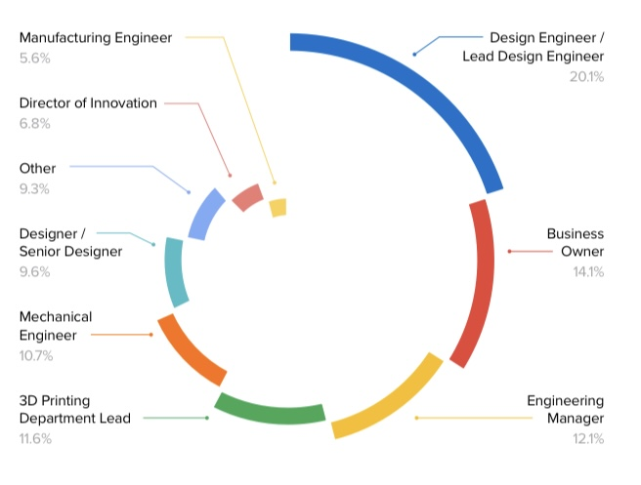
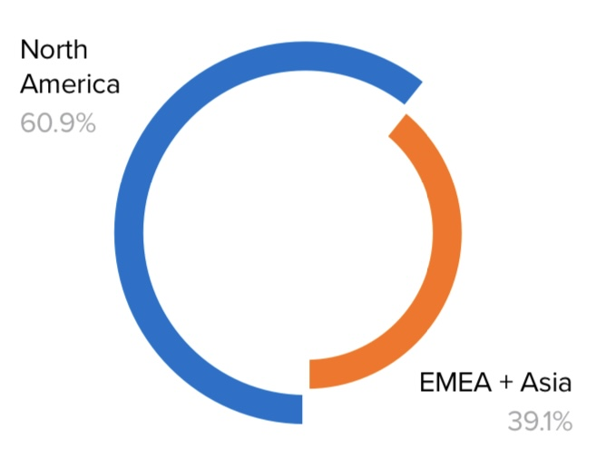
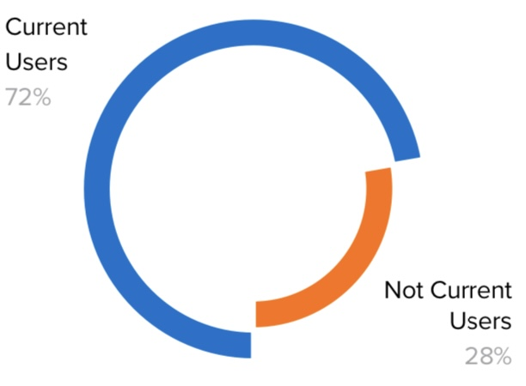
Research Panel by Occupation
Research Panel by Location
72% of 400 respondents
currently use 3D printing, while
28% of respondents do not.
The 2022 3D Printing Applications Report, Formlabs.
Notes:
Harry
North America, digital dentistry,

Slide 11
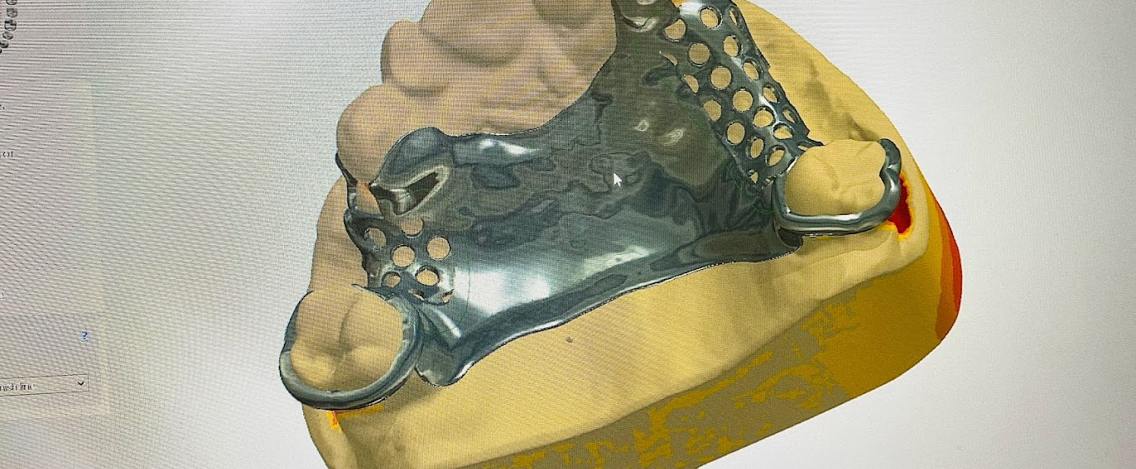
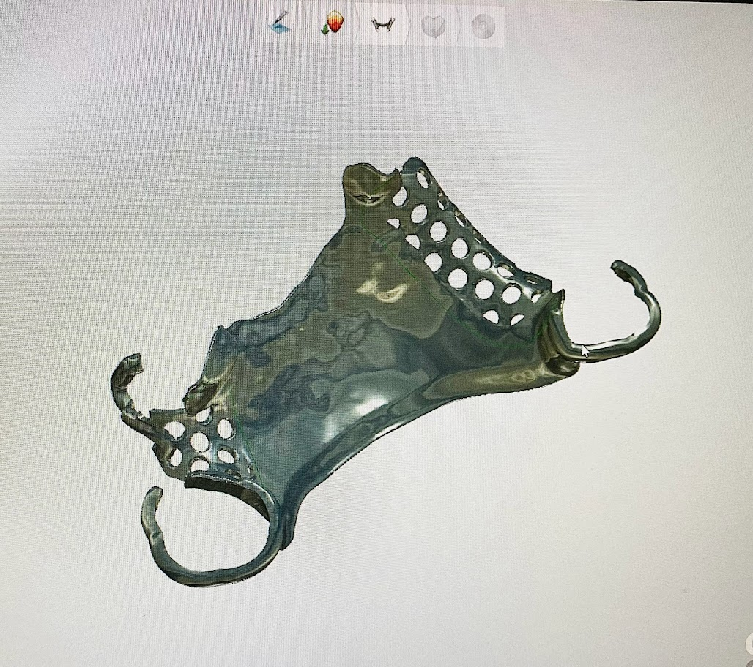
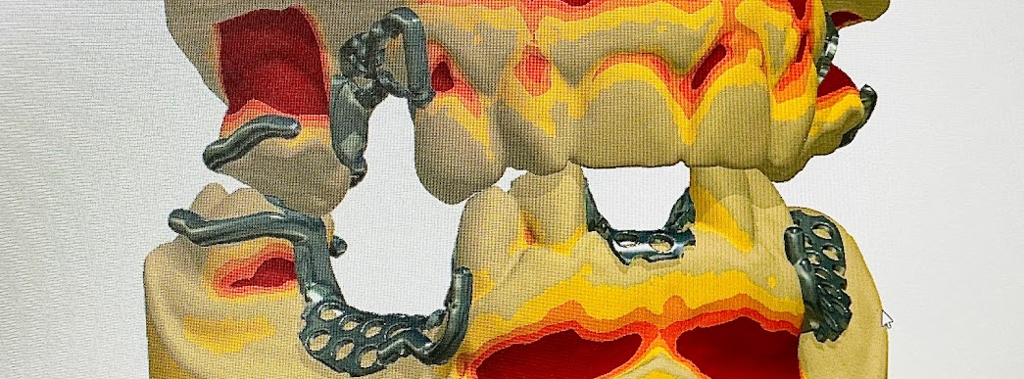
“Computer-Aided Design and Computer-Aided Manufacturing (CAD/CAM) is an important and irreplaceable technology in contemporary dentistry” Maltar, (2018).
“There is no doubt that a digital revolution in dentistry has arrived with the advanced development of digital workflow, including CAD/CAM” Neville et al. (2020).
“Dental educators must also stay current with emerging technologies as they are developed and implemented in order to provide the most comprehensive education to their students” Brownstein et al. (2015).
“Digital dentistry, including CAD/CAM dentistry, is perhaps the most disruptive innovation in dentistry to date” Bencharit et al. (2021).
Notes:
Stephen
CAD/CAM research

Slide 12

64 BDS2 Students were asked if they had any understanding of the Digital Workflow in Dentistry prior to their Digital Design Session, February 2022. 93% said No, while 7% said Yes.
BDS2 In-Class Poll (2022).
Notes:
Stephen
Student Poll

Slide 13
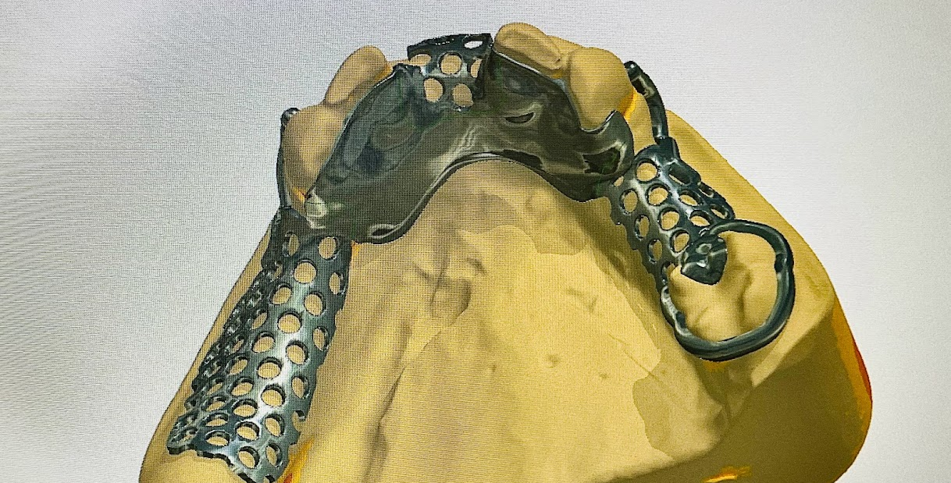
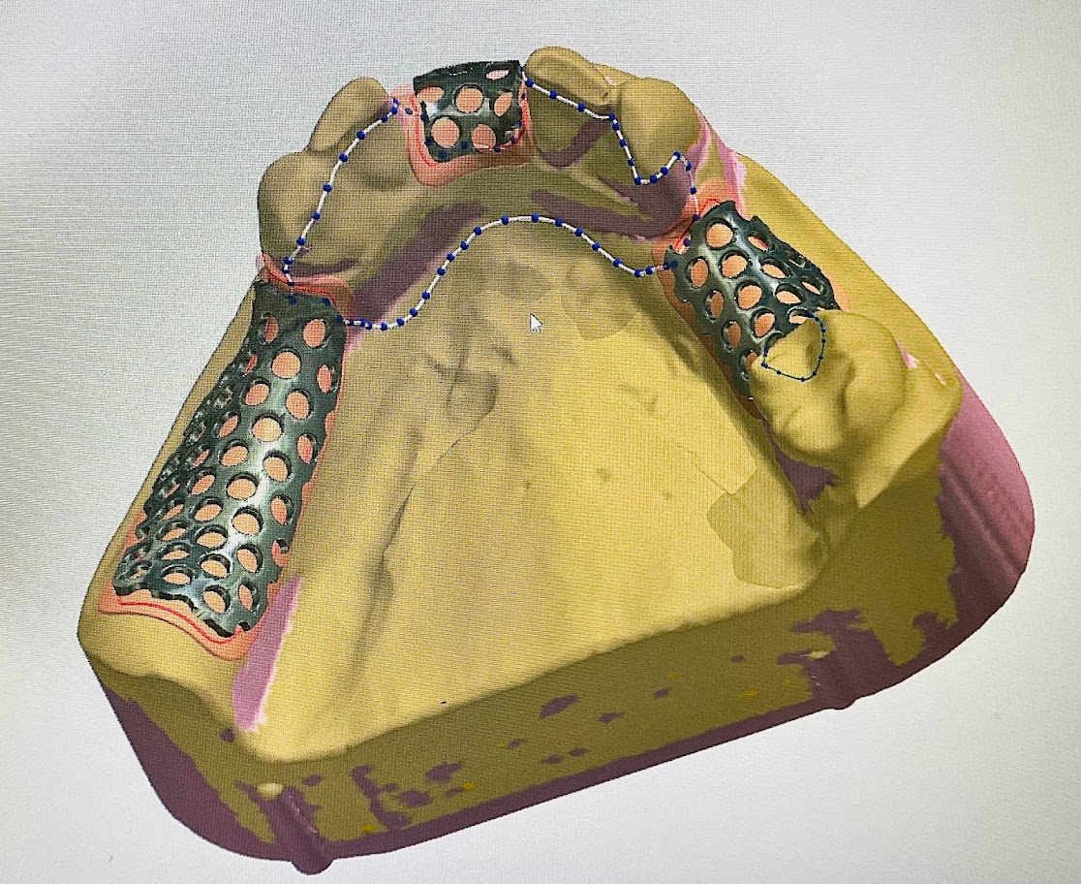
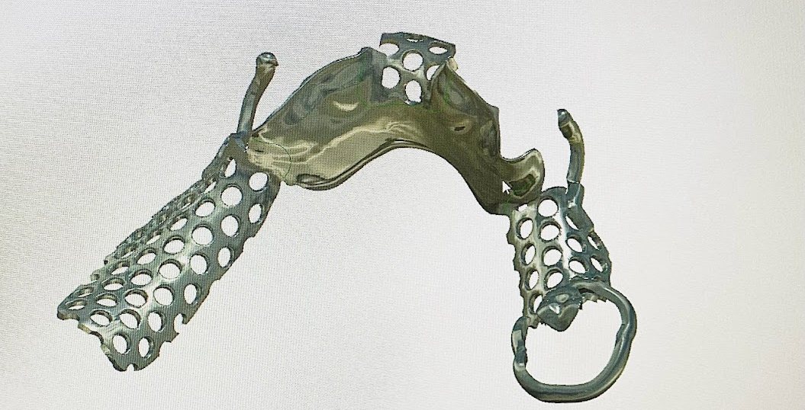
Notes:
50/50
Digital versus Analogue

Slide 14
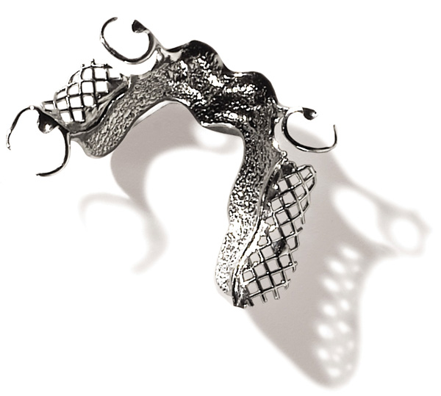
2 Dimensional Framework
CAD Framework
Cobalt Chrome Framework
Notes:
50/50
Showing again the quality of the CAD framework, visual understanding
Lots of us haven’t seen this
This digitally is way better

Slide 15
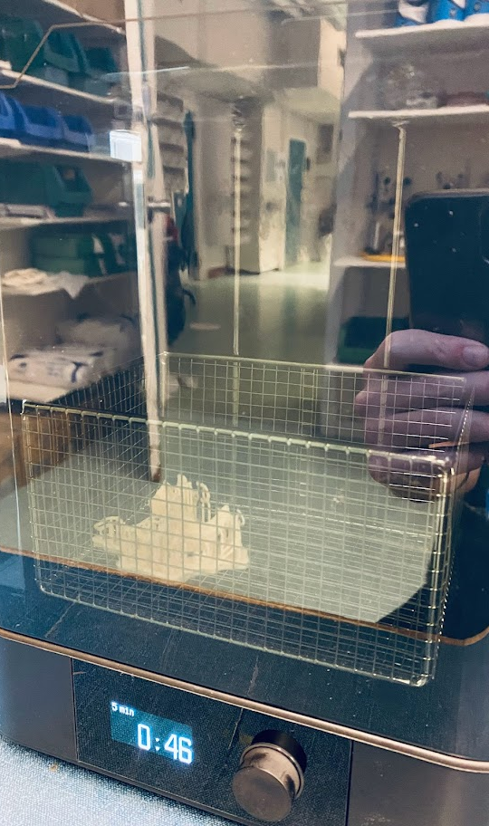
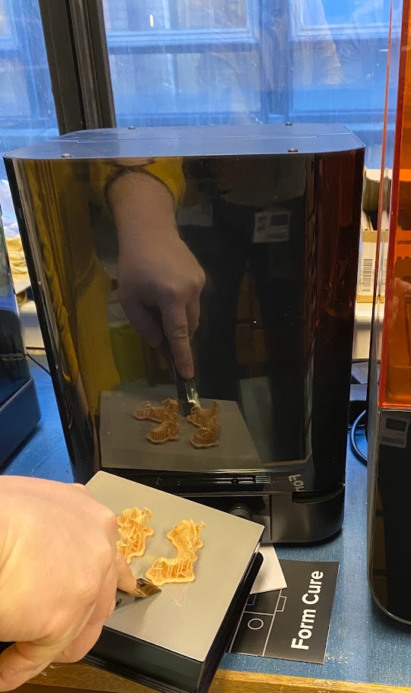
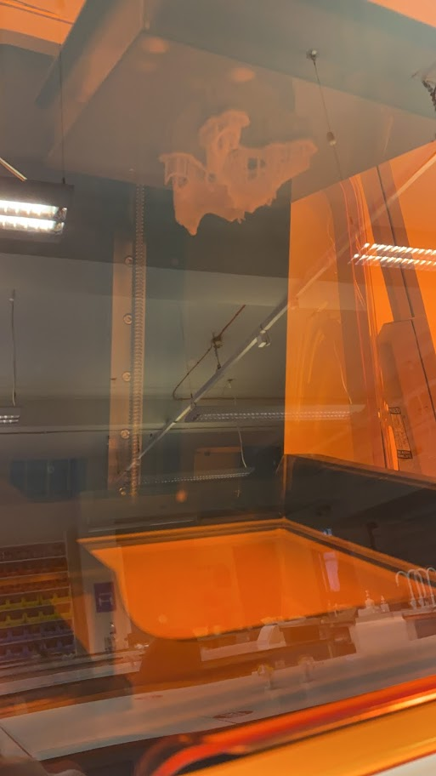
Notes:
Harry
Talk about 3D printing process
Not that simple yet

Slide 16
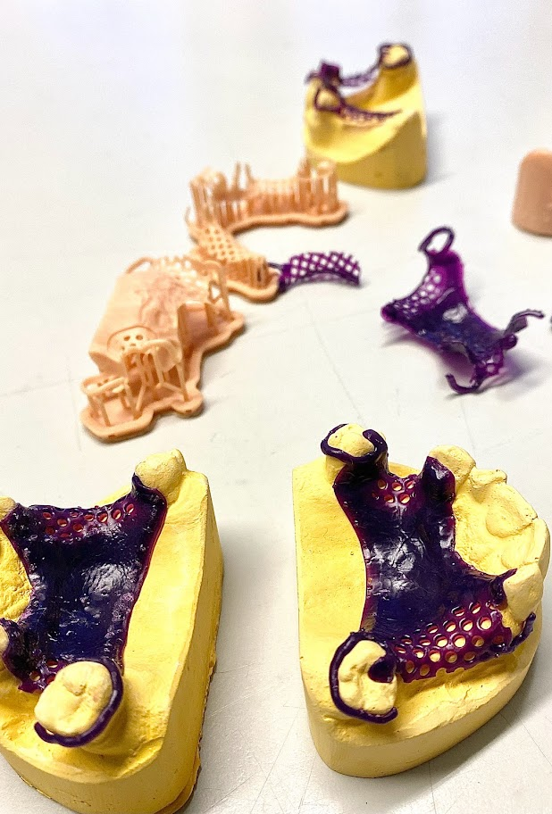
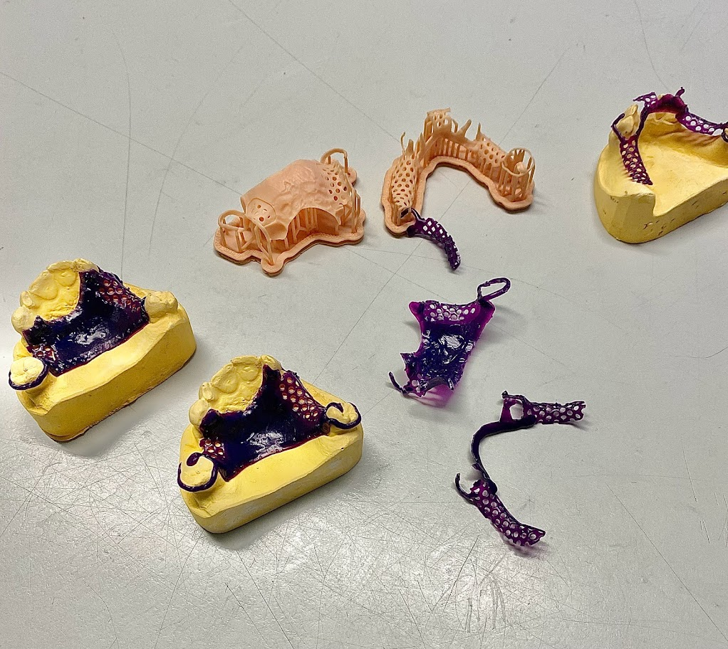
3D Printed CAD/CAM Frameworks
Notes:
50/50
Different resins, actually got to manufacture frameworks
Signpost and speculate

Slide 17

“Dentistry is continually changing, and we are seeing a move to the digital environment”.
“We continue to evolve our curriculum to reflect this shift”.
“If we are to avoid being left behind, we need further investment in Digital Dentistry”.
University of Glasgow Dental School, Periodic Subject Review (BDS), Reflective Analysis Report. February (2022).

Slide 18
References:
Almufleh, B., Emami, E., Alesawy, A., Rodan, R., Morris, M., Umebayashi, M., & Tamimi, F. (2020). Patient‐Reported Outcomes of Metal and Acrylic Resin Removable Partial Dentures: A Systematic Review and Meta‐Analysis. Journal of Prosthodontics, 29(5), 378-386.
Bencharit, S., Clark, W. A., Stoner, L. O., Chiang, G., & Sulaiman, T. A. (2021). Recent Advancements in CAD/CAM Same-Day Dentistry in Practice and Education.
Brownstein, S. A., Murad, A., & Hunt, R. J. (2015). Implementation of new technologies in US dental school curricula. Journal of dental education, 79(3), 259-264.
Formlabs (2022). A report exploring the past, present and future trends of 3D printing’s role in manufacturing. The 2022 3D Printing Applications Report. Available at: https://formlabs.com/3d-printing-applications-report-2022/?utm_source=direct&utm_medium=email&utm_campaign=whitepaper-email-announcement-feb-22-na&mkt_tok=MDYwLVVJRy01MDQAAAGClopBMMv7mIaOhBbO1Ik2_SLZZR_dkOBe0askG3CgNC90wnVDlePHIhSdzU--Q9gUdjklWpZl_x7CbvtJT_kYdCjIOUdM5CIM7AfgqkIpMf9nEIA
Loch, C., Brunton, P. A., Rahim, Z. A., Liew, L., Lynch, C. D., Wilson, N., ... & Jum’ah, A. A. (2020). The teaching of removable partial dentures in dental schools in Oceania. Journal of Dentistry, 95, 103309.
Lynch, C. D., & Allen, P. F. (2007). The teaching of removable partial dentures in Ireland and the United Kingdom. British Dental Journal, 203(8), E17-E17.
Maltar, M., Miloš, L., Milardović, S., Kovačić, I., Peršić, S., Juroš, I. and Kranjčić, J., 2018. Attitudes of the students from the School of Dental Medicine in Zagreb towards CAD/CAM. Acta Stomatologica Croatica, 52(4), p.322.
Neville, P. and van der Zande, M.M., 2020. Dentistry, e-health and digitalisation: A critical narrative review of the dental literature on digital technologies with insights from health and technology studies. Community Dent. Health, 37, pp.51-58.

Slide 19



Thank you for listening
#UofGWorldChangers
@UofGlasgow

