Slide 1
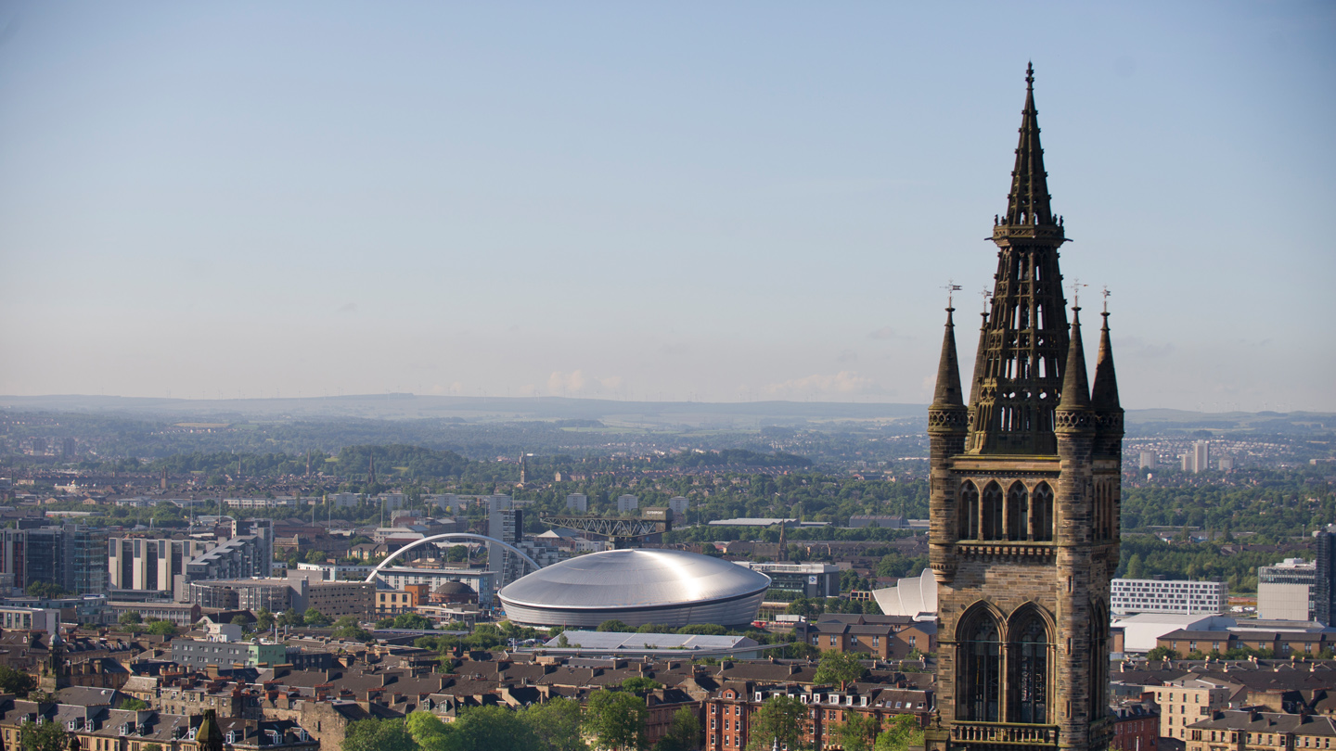


INNOVATION STRATEGY 2020-2025

Slide 2

WHAT IS INNOVATION AND WHAT CONTRIBUTES TO it?
1
Innovation is the realisation of ideas into new processes, methods, products and services.
Building on the Muscatelli and Logan Reviews, this presentation lays out the UofG Innovation Eco-System and breaks down each component part into the outcomes and tasks required. To achieve this and place the University at the heart of entrepreneurship in Glasgow will require building capacity and capability as well as capital investment to create partnership hubs with our commercial partners.
Quality & volume
of ideas
Ideas that can be formed economic and/or social spin-outs, ventures or enterprises and locate and grow in Glasgow
3
2
Co-creation
Planning
Co-create with the communities in the Innovation District
Identify new clusters
Social, cultural and economic activities which are aligned with the University’s research and demonstrate potential for application at scale in Glasgow
16TH FEBRUARY 2021
SLIDE 2
INNOVATION STRATEGY

Slide 3







USING innovation TO STRENGTHEN ENTREPREUNERSHIP
Colleges
Funding Opportunties
We will support the formation of companies and social enterprises in our current pipeline from the Colleges to increase the number and likelihood of success of the pipeline
Refine our translation and commercialisation activities and create an investment fund to bridge funding gaps and to co-invest with external investors.. Broker external partnerships and identify funding options
Technology Transfer Office
Academics
Commercialisation
Strengthen our capability and awareness in innovation activities related to commercial realisations. Incentivise academic participation in entrepreneurship and broaden mission driven social enterprise
Identify ways to Increase the amount of core university funding supporting commercialisation over time, calibrated against demonstrable progress in growing a project pipeline.
Planning
Staff and Students
Innovation District
Provide training, expert advice, mentoring, competition and event delivery, news and comms, mentorship, IP/finance/legal advice and proof of concept support to students and non-academic staff
Bridging the University and GRID will support new industry-university clusters. The TTO will support the development of the clusters through identifying sector experts, intellectual property to be protected and enabling enterprise formation.
16TH FEBRUARY 2021
SLIDE 3
INNOVATION STRATEGY

Slide 4





WHAT IS OUR INNOVATION STRATEGY ECOSYSTEM?
Innovation Clusters
Co-location and GRID
Communication & Culture
Soft Support
Investment
Planning
We need the ability to support the formation of companies and social enterprises in our current pipeline from the colleges. ‘Soft support’ includes the elements that a new venture, enterprise, spin-out, licence agreement needs
Once opportunities have been identified with Colleges, we will work with sector experts to define the tools needed for their development. We will define the tools needed for their development, identify leadership, clarify missions, broker external partnerships and identify funding options.
An innovation ecosystem is place-based. It requires co-location of different stakeholders in order to generate the cross-fertilisation that enables translation of research into benefits.
Funding for the ecosystem will be generated from internal and external sources, including from mission-driven funding streams that form part of the R&D Roadmap.
Engage with the research community to address the uncertainty and relevance of innovation activities to the University and the potential options for their careers. This will include more frequent communication from SMG, review of review of policies and practices to include and to recognise the value of such activities
16TH FEBRUARY 2021
SLIDE 4
INNOVATION STRATEGY

Slide 5





TRANSLATING THE STRATEGY INTO DELIVERY PLANS
Soft Support
INNOVATION CLUSTERS
Co-location & grid
investment
Comms & culture
Renew the University’s IP and HR policies
Develop an effective collaborative framework
Undertake opportunity audits
Define and deliver structured support packages
Invest in materials and resource
Facilitate entry to external competitions and programmes
Identify and define a target of five innovation clusters
Develop leadership, “brand” and co-ordination resource
Assign Research/Business Development resource to build networks of partnerships
Review services offered and management of existing hubs
Design, cost, and identify internal/external funding sources
Design an operational blended space model
Define and build hub(s) for partner co-location
Specify, cost and ultimately deliver the service offer
Build a pathway that provides tenancy terms and conditions
Develop the hubs
Create alignment between central and college funds
invest in research/business development managers
invest in dedicated support
Invest in support to assist students and academics
Invest in communications capacity and expertise
Initiate an investment fund
Source public sector capital investment for physical infrastructure
Socialise the strategy
Create internal materials (webpages, news feeds, regular updates)
Develop a schedule of seminars and networking events
Build the innovation strategy into all communications and reporting
Explain the ecosystem vision and the roadmap to external funders
16TH FEBRUARY 2021
SLIDE 5
INNOVATION STRATEGY

Slide 6

WHAT IS OUR VISION AND GOALS?
Within 5 years, we will build an innovation eco-system that is the engine for growth in the Glasgow City Region. Within 10 years, we will have the scale and wherewithal to be a major contributor through new sectors, clusters and industries to the prosperity and well-being of Glasgow.
Physical spaces
Emerging industry
Pipeline of ideas
New career options for students and staff
New entrepreneurial clusters and communities
External Partners
Talent pools
Planning
Experienced support
Social and cultural communities and senior leadership
Shared ambitions
16TH FEBRUARY 2021
SLIDE 6
INNOVATION STRATEGY

Slide 7
Summary - INNOVATION STRATEGY 5 YEAR OVERVIEW
 | 2021 |  |  |  |  |  |  |  |  |  |  |  | 2022 |  |  |  |  |  |  |  |  |  |  |  | 2023 |  |  |  |  |  |  |  |  |  |  |  | 2024 |  |  |  |  |  |  |  |  |  |  |  | 2025
 | PHASE 1 Augment and expand our current translation and commercialisation strengths |  |  |  |  |  |  |  |  |  |  |  |  |  |  |  |  |  |  |  |  |  |  |  | PHASE 2 Create investment, design and deliver Hub(s), develop our entrepreneurship and identify cluster development opportunities
Soft Support
Clusters
Co-location
Investment
Comms & Culture
Cost
Outcome | Create the Technology Transfer Office (TTO) and expand the volume and quality of opportunities |  |  |  |  |  |  |  |  |  |  |  | Increase the knowledge and awareness in the university community of the potential benefits of an innovation eco-system |  |  |  |  |  |  |  |  |  |  |  | Funding models that put UofG in a leading position for innovation and makes us more competitive |  |  |  |  |  |  |  |  |  |  |  | Hub(s) that promotes the growth and success of the ecosystem as a whole |  |  |  |  |  |  |  |  |  |  |  | A fully integrated innovation ecosystem directly contributing to our World Changing Strategy
Renew University´s IP/HR policies. Develop framework
Facilitate opportunities and entry to external competitions and programmes
Build team to define and deliver structured support packages
Identify and define targets of 5 translational clusters
Develop leadership and brand
Build networks of partnerships
Design, cost and deliver the refurbishment of Church Street Innovation Zone
Define and build hub)s within GRID alongside University investments
Develop spaces for communication engagement as part of civic mission
Align central and college funds to focus on opportunities
Initiate an investment fund to back Glasgow enterprises
Source public sector capital investment
Planning
Develop and deliver Communications and Engagement Strategy as part of Innovation Strategy
Develop suite of internal reporting and KPIs to demonstrate the impact of the innovation ecosystem
Develop and implement initiatives that address the priority of innovation and entrepreneurship
16TH FEBRUARY 2021
SLIDE 7
INNOVATION STRATEGY

Slide 8
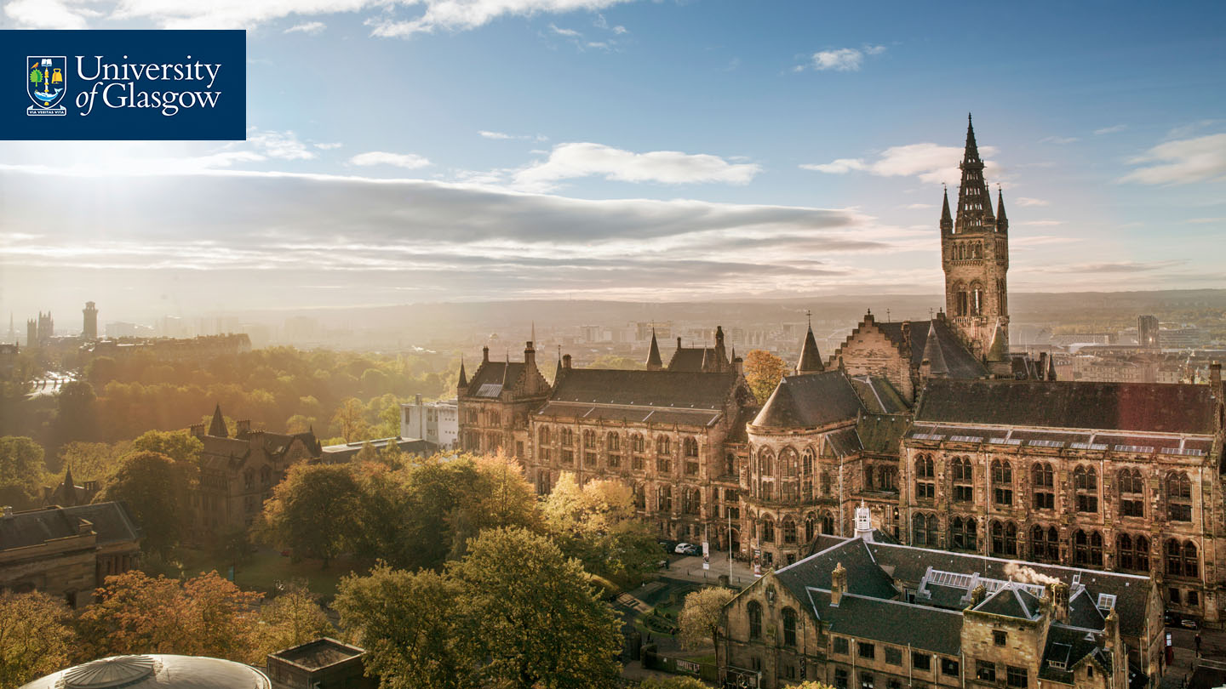


#UofGWorldChangers
@UofGlasgow

