Slide 1
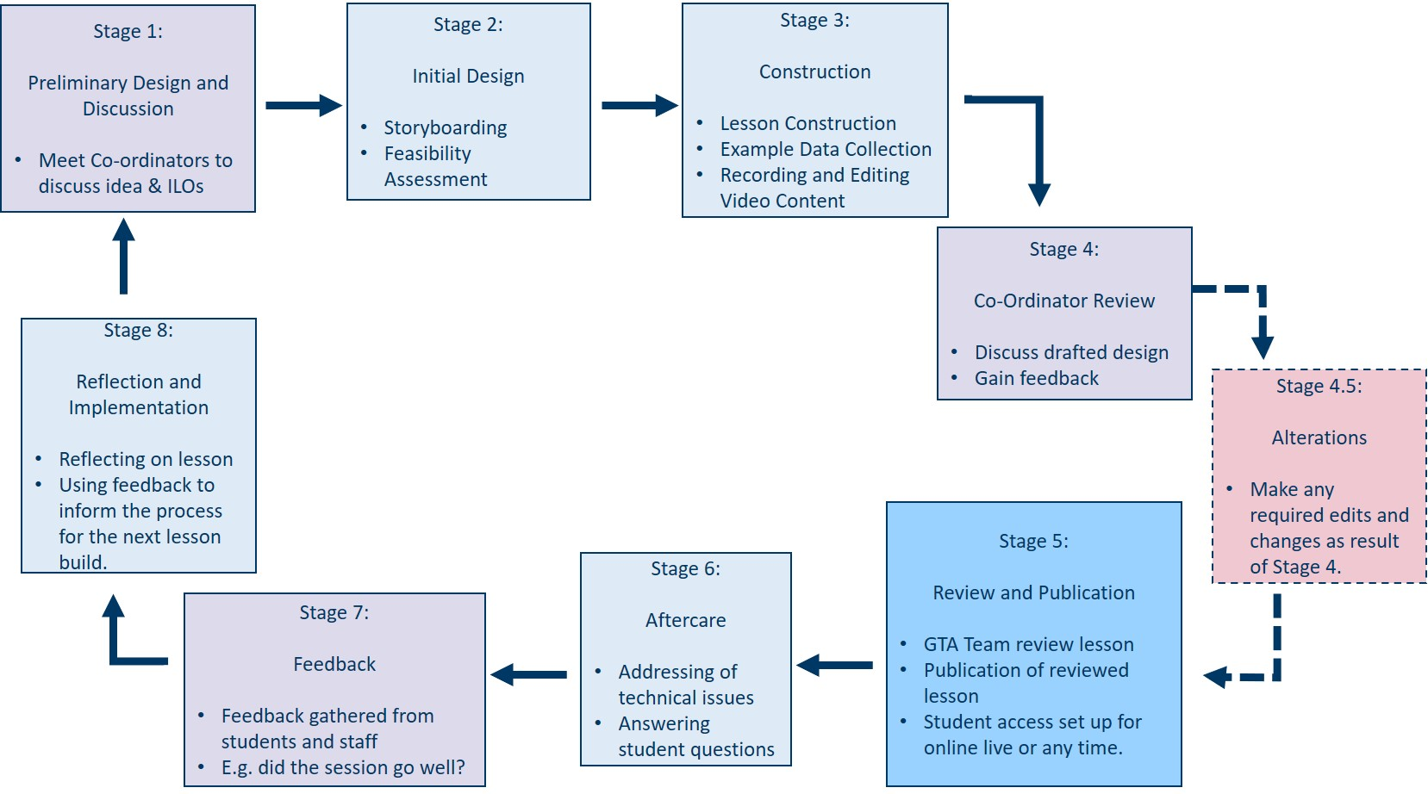
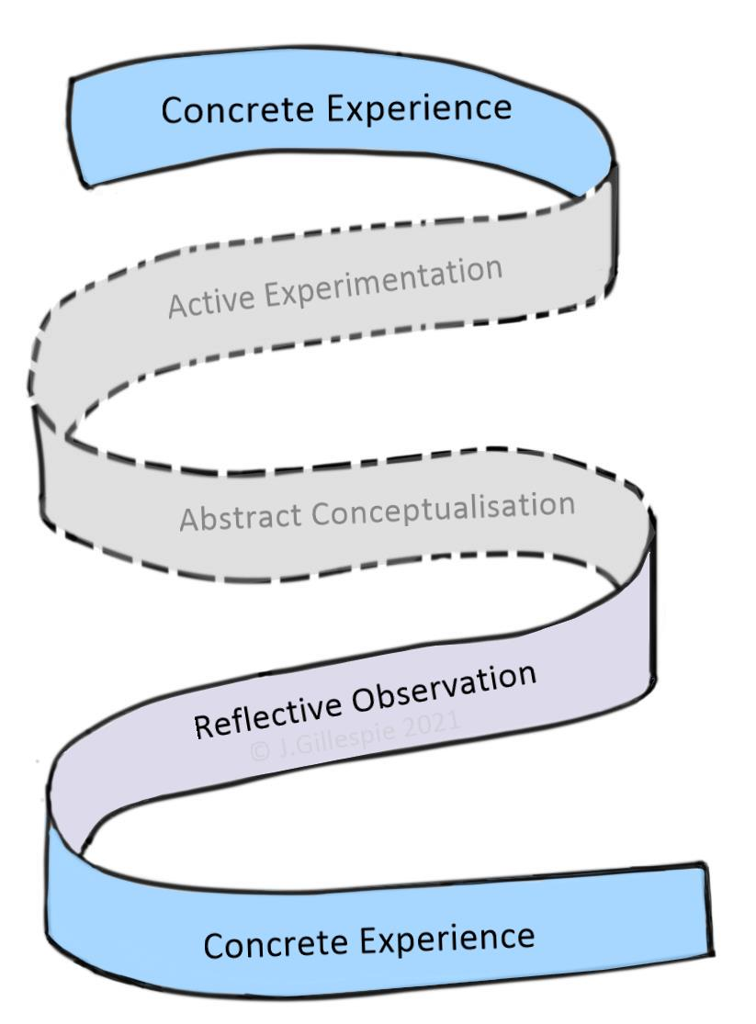
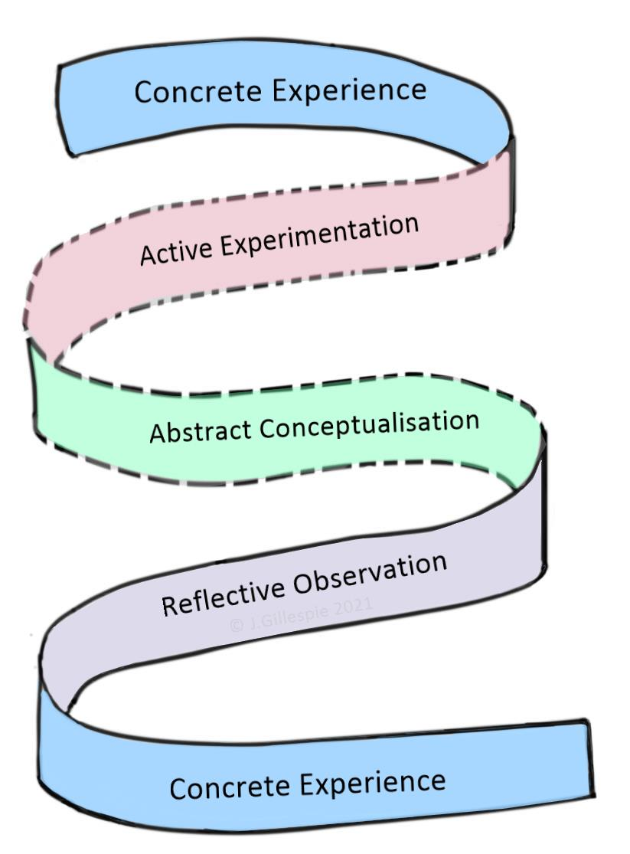
Entrusting and Empowering: Embedding GTAs in Course Development
Michael Duncan, Jennifer Gillespie, Neil Russell – School of Life Sciences, University of Glasgow
Development of the GTA role throughout the ongoing COVID-19 pandemic:
Pandemic Onset & New Challenges
Meeting the Challenge
Challenges for a Post-Pandemic World----
Background GTAs (Graduate Teaching Assistants), of which there are currently 115 in the School of Life Sciences alone, perform important teaching support roles but typically have limited input into the creation and implementation of new teaching content. The experiential learning cycle (Kolb and Kolb, 2018) demonstrates that these two areas, known more specifically as “abstract conceptualisation” and “active experimentation” respectively, are key to developing as an educator, and without these opportunities, GTA professional development is limited. This is visualised in the adapted image of Kolb’s cycle below, with these inaccessible areas highlighted in grey with dashed lines.
Click the above image hyperlink to view this video.
Take Home Messages
With the changing role of digital technology in education, GTAs with specialist skills can be utilised in course development.
This allows for access to all areas of the learning cycle, as illustrated by the image below, enabling professional development.
Click the above image hyperlink to view this video.
Figure 1: Creating an Lt Lesson
This flowchart demonstrates the different stages of creating online learning resources using Lt Kuracloud. Stages which are co-operative with course co-ordinators or students (Stages 1, 4 and 7) are shown in lilac, stages which are the GTA component of the Lt team individually (Stages 2 ,3, 6 and 8) are highlighted in pale blue, any stage which involves other GTAs specifically (Stage 5) is a deeper blue and any stage which is not a permanent feature and is only included when necessary (Stage 4.5) is denoted in pale burgundy with dashed lines.

