Slide 1
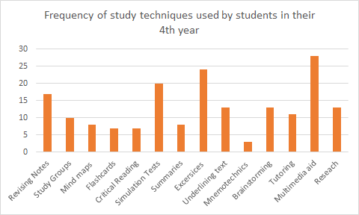
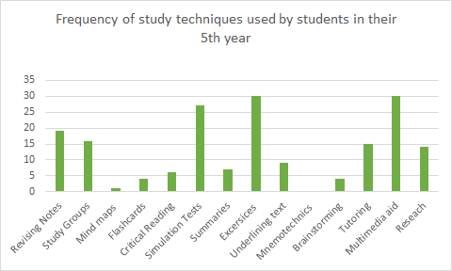
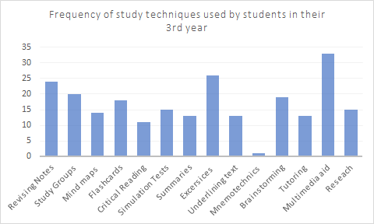
Performance Differences from a TOEFL Simulation in San Miguel, El Salvador
Introduction
Conclusions and recommendations
The standardized test TOEFL is used to assess English language development in non-English speakers. When the first TOEFL test was developed, linguistic theories viewed linguistic competence as a set of independent components such as grammar, vocabulary and comprehension (Carroll, 1961). This study intended to determine the differences of performance in a TOEFL test simulation to compare the development of the macro abilities that the students of 3rd, 4th and 5th year of the Bachelor Degree in English Language Teaching are developing in the Gerardo Barrios University of San Miguel. It is necessary to understand how some activities outside the academic setting influence the development of language skills to analyze them properly. At the same time, a detailed record of the progress that students acquire annually was tracked with the administration of the digitized TOEFL test simulation in the UGB Canvas platform.
The passing of time and academic instruction of students seems to have a positive influence on their performance on a TOEFL test.
Certain study techniques appear to have a positive impact on test performance, specifically, taking TOEFL mockups (or simulations) as well as revising notes, critical reading, and research.
The cohort analysis also provided evidence that subjects in more advanced years appeared to perform better on English language achievement tests.
It is recommended to review the contents of the TOEFL Preparation Course in light of these results in order to consider what areas for improvement could promote the increase of the impact that the course has on the preparation of students.
Methodology
This study was conducted under a longitudinal design. Parallel to the expected longitudinal changes, the research team decided to follow the recommendation of Rajulton (2001) to accompany the comparison of indicators in search for explanatory relationships that denote the nature of these changes between measurements. The sample (n = 108) was composed of 68% of women (n = 74), it was chosen with a non-random sampling of a proactive type (Morales, 2012).
Three digitized instruments were used: Survey of study habits and parallel training strategies, Scale of self-perception of performance in the English language and TOEFL ITP test simulation.
References
Canjura, M. (2016, Marzo 3). Ministerio de Educación de El Salvador. Retrieved 2018, from http://www.mined.gob.sv/jdownloads/Educacin%20Superior/Informacion%20Estadistica%20de%20Educacion%20Superior/Resultados%20de%20la%20Informacion%20de%20IES%202016%20VPreliminar.pdf
Carroll, J. B. (1961). Fundamental considerations in testing for English proficiency of foreign students. Washington, DC: Center for Applied Linguistics.
Long, M. H. (1983). Does Second Language Instruction Make a Difference? A review of reseach. TESOL quarterly, 17(3), 359-382.
Rajulton, F. (2001). The fundamentals of longitudinal research: an overview. Canadian Studies in Population, 28(2), 169-185.
ETS. (2011). TOEFL Program History. TOEFL iBT Research Insight. Retrieved from https://www.ets.org/s/toefl/pdf/toefl_ibt_insight_s1v6.pdf
Results
Regarding study techniques used by participants, when performing a Kruskal-Wallis test significant differences were found, the 4th year cohort presented a mean (m = 6.07, σ = 2.08) similar to that of the 3rd year (m = 6.03, σ = 2.76), however, it also presented a higher standard deviation, therefore, we can argue that there is less agreement in the amount of evaluation techniques used in this group. On the same regard, the 5th-year group presented the lowest average (m = 4.67, σ = 2.14), being, therefore, the group that uses the least study techniques, preferring exercises, pilot tests and multimedia.
Jeany Argueta¹ , Antonio Trejo¹, José Villanueva¹, Gustavo LaFontaine²
¹Gerardo Barrios University, Calle Las Flores y Avenida Las Magnolias, Colonia Escolán, San Miguel, El Salvador.
² Department of Sciences and Human Behavior, Universidad Metropolitana, Caracas, Venezuela
Two analyzes were carried out to study the longitudinal effect in the sample, the first one who were in the 3rd year in 2017 and in the 4th year in 2018 and the second with students who were in the 4th year in 2017 and in the 5th in 2018. Based on the analysis done, it was expected that the greatest difference between the results of 2017 and 2018 would be in the second group (from 4th to 5th), as they took the subjects that predicted better performance in the tests, and indeed, that was the case.
Descriptive Statistics students from 3rd to 4th year of their major
 | N | Mean | Est. Dev
Listening 2018 | 28 | 19.96 | 9.159
Listening 2017 | 28 | 24.46 | 9.033
Grammar 2018 | 28 | 17.93 | 7.282
Grammar 2017 | 28 | 16.18 | 5.121
Reading 2018 | 28 | 21.79 | 10.163
Reading 2017 | 28 | 23.82 | 7.035
Total 2018 | 28 | 417.00 | 66.708
Total 2017 | 28 | 427.46 | 50.908
Descriptive Statistics students from 4th to 5th year of their major
 | N | Mean | Est. Dev.
Listening 2018 | 26 | 25.77 | 7.748
Listening 2017 | 26 | 20.46 | 8.668
Grammar 2018 | 26 | 22.62 | 7.425
Grammar 2017 | 26 | 16.27 | 5.356
Reading 2018 | 26 | 27.85 | 8.264
Reading 2017 | 26 | 23.15 | 7.369
Total 2018 | 26 | 466.19 | 61.961
Total 2017 | 26 | 416.04 | 51.993
Licda. Jeany Argueta
jlis22@ugb.edu.sv

