Slide 1
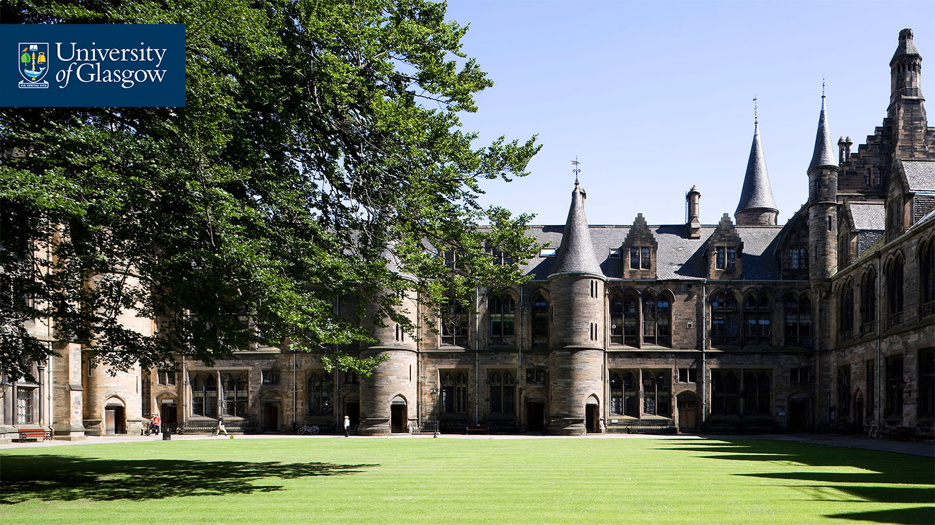
Flipping lessons with Moodle:
using H5P Moodle feature to deliver
interactive online sessions.
Jolanta Hudson
English for Academic Study
School Of Modern Languages and Cultures
University of Glasgow.

Slide 2

Contents
Why should I flip my class?
What’s H5P?
Adapting the lesson material
Using Moodle H5P feature to create the content
Engaging the students
Using the interactive content
Feedback from students
Reflections

Slide 3
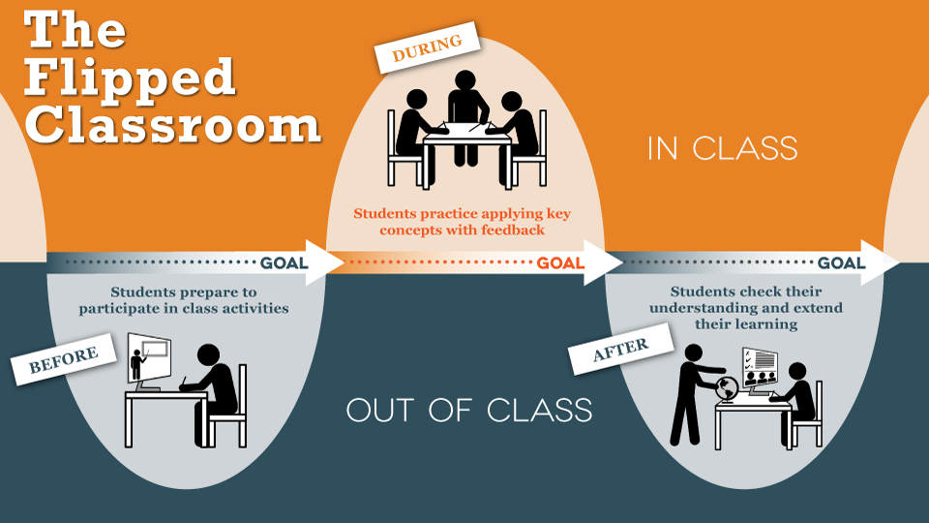
Flipped Classroom
In this approach, students can have increased input and control over their own learning, as opposed to the more traditional teacher-centred approach (Nottingham Trent University, 2013).
Source: The University of Texas at Austin (2019).

Slide 4
Why should I flip my class?
Flipped Classroom is a pedagogical approach in which all or some of direct instruction is moved outside of the face-to-face environment to dedicate more in-class time to ‘hands-on’, experimental, engaging and ‘active learning’ activities.
(Roehl et al., 2013 in Pechenkina 2017:1).
Incorporating technology that provides students with the opportunity to manage their learning in a more ‘proactive way’ (HEA, 2017) promotes the student-centred learning approach to teaching.

Slide 5

Adapting the lesson material
Class: English for Academic Purposes 1 (EAP 1).
This is an in-sessional course for study abroad year and international students. The course reviews and practises essential Academic English language and skills to support the students’ undergraduate study.
Topic: Reading into Writing - Using Sources 2
Session Aims:
practise integrating sources into your writing
to learn how to show your stance
practise note-taking.

Slide 6
Selected screenshots of the Course Moodle pages

Slide 7
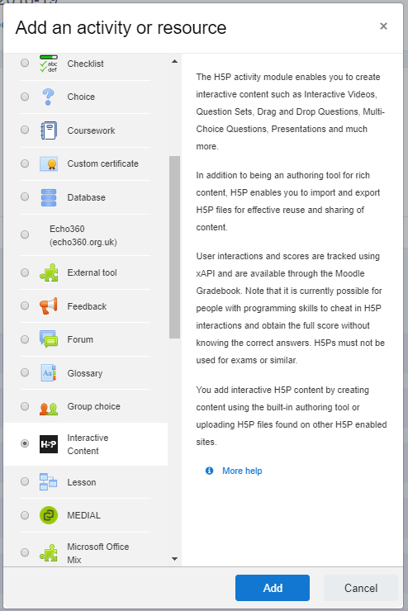
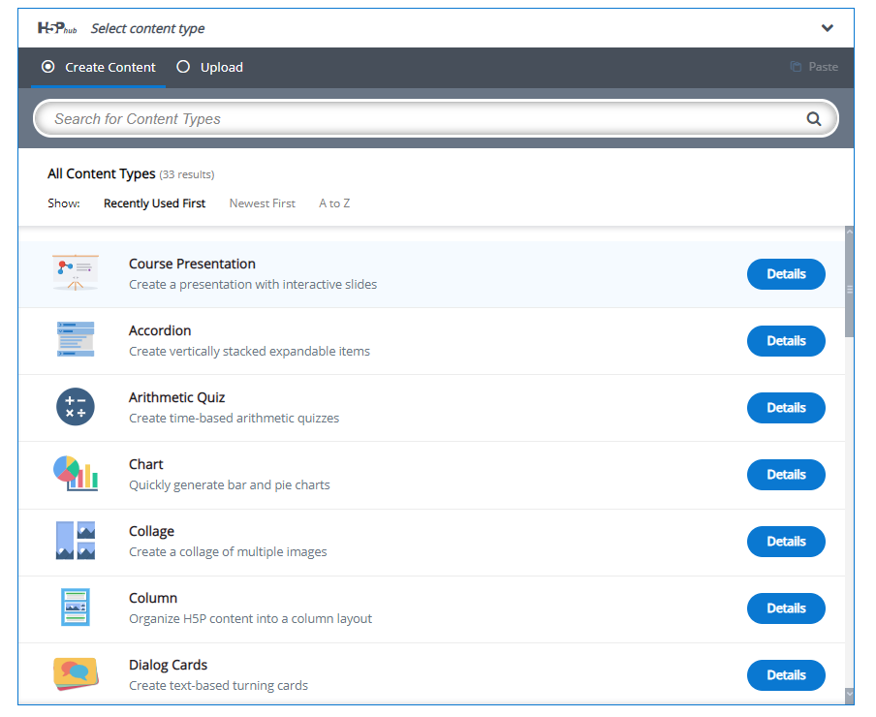
Adding H5P to a Moodle page
H5P content types

Slide 8
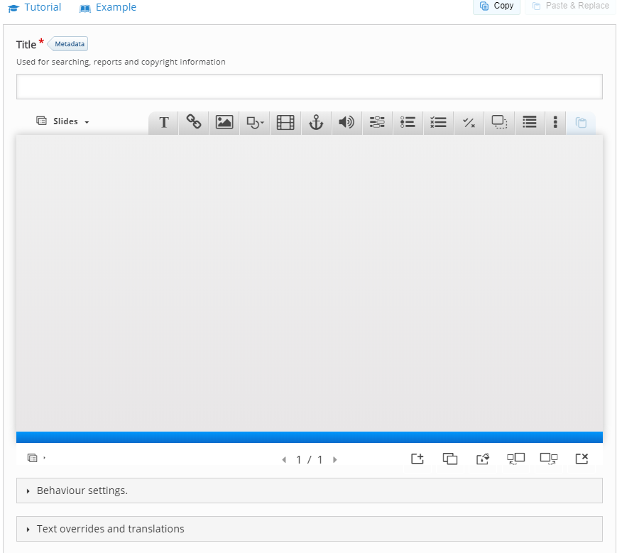
H5P Course Presentation

Slide 9
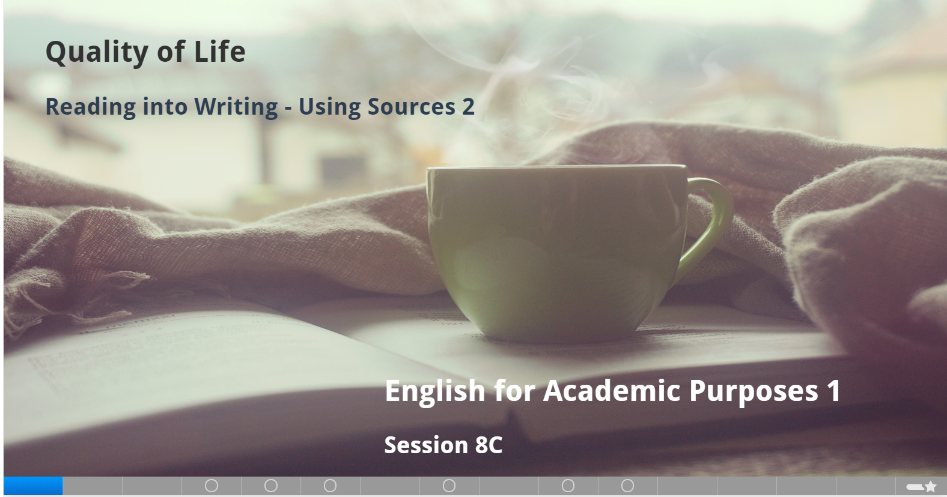
Session slides

Slide 10
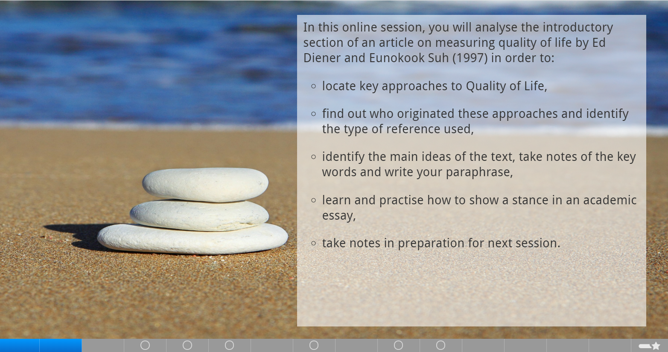

Slide 11
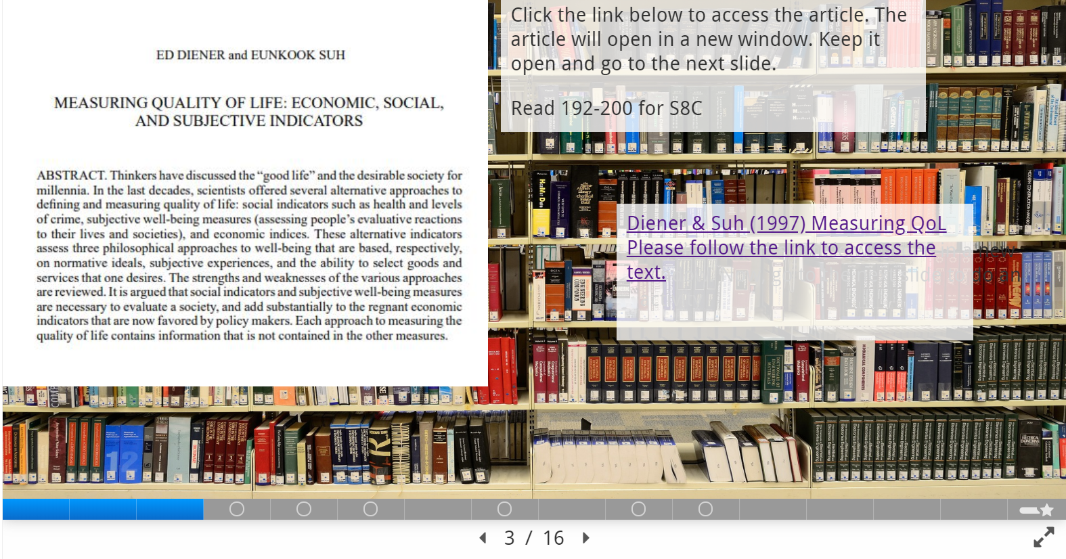

Slide 12
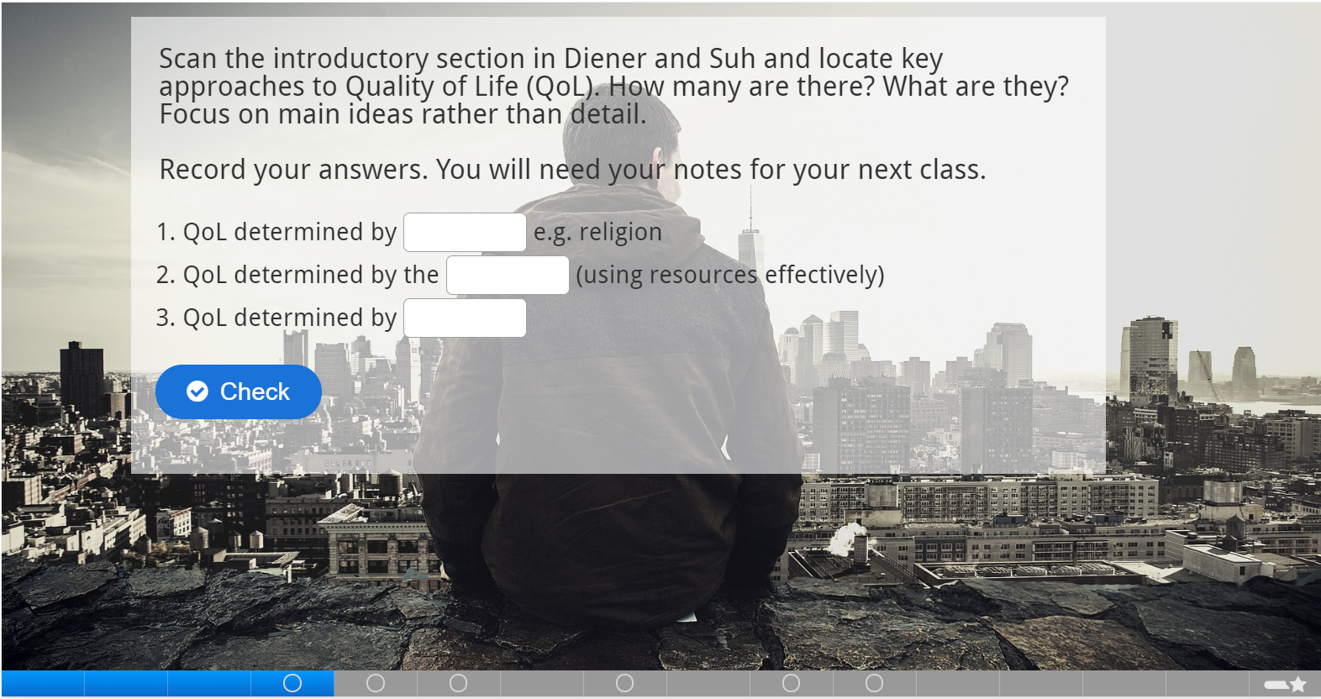

Slide 13
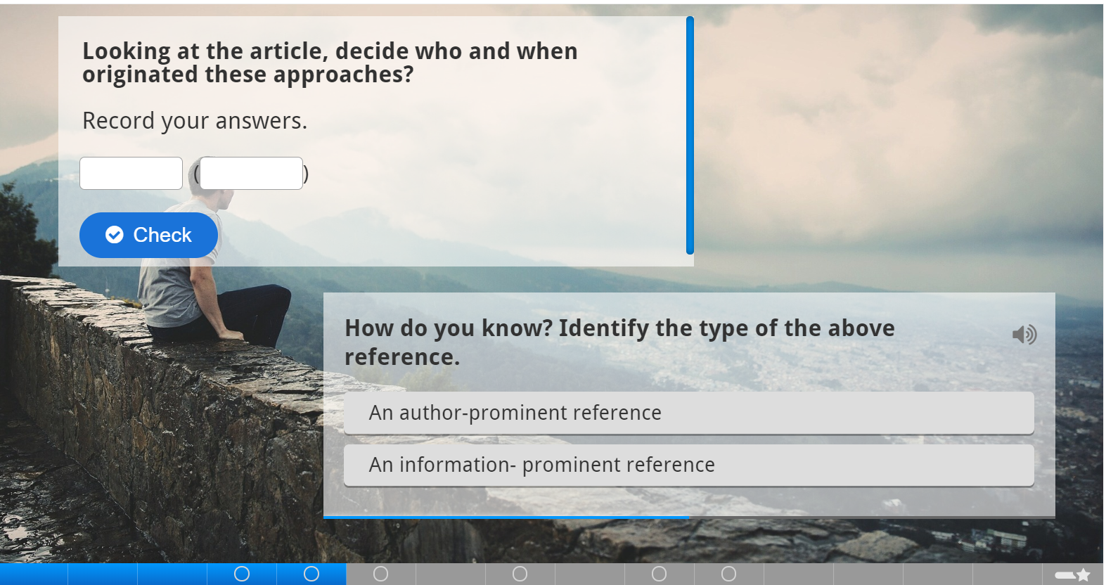

Slide 14
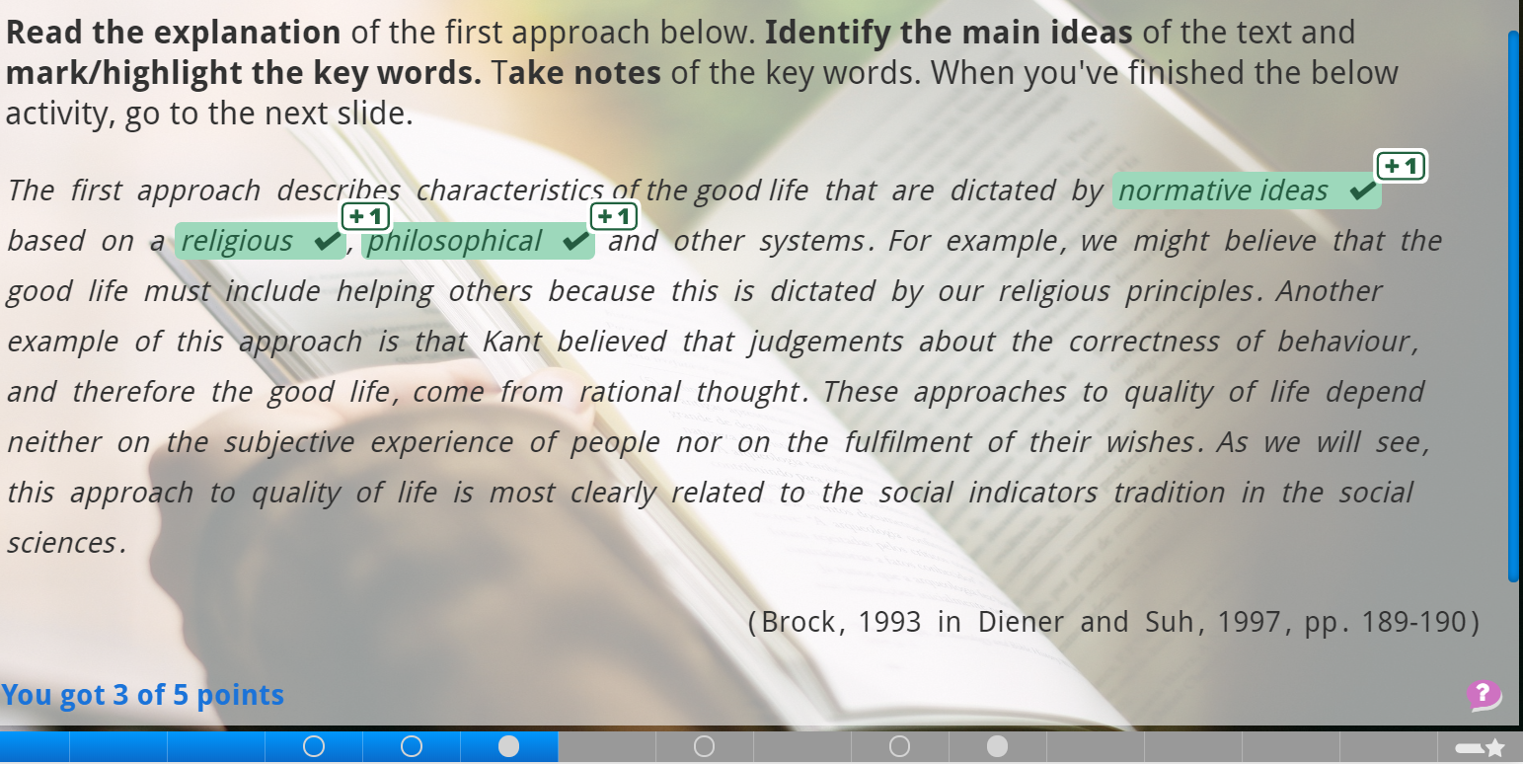

Slide 15
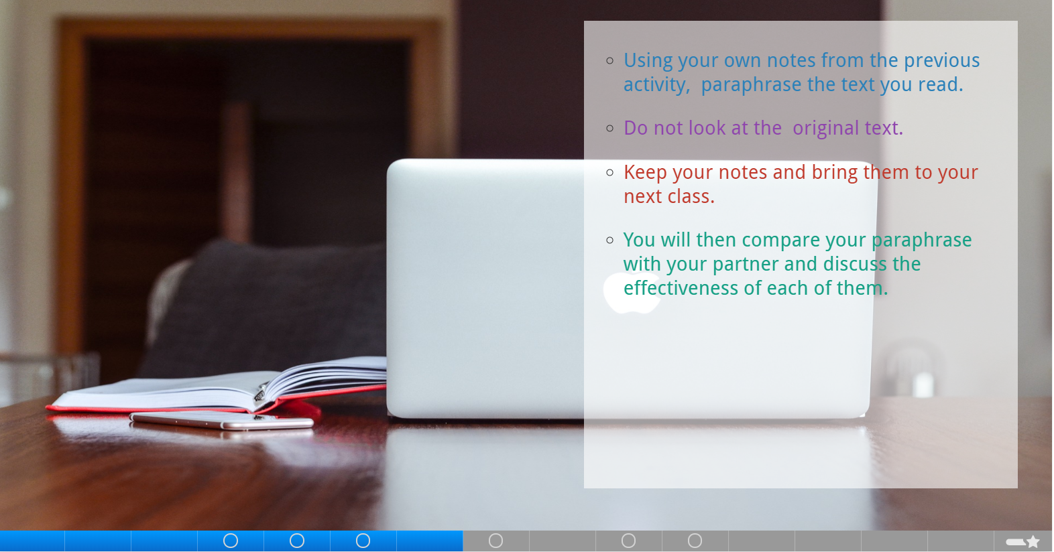

Slide 16
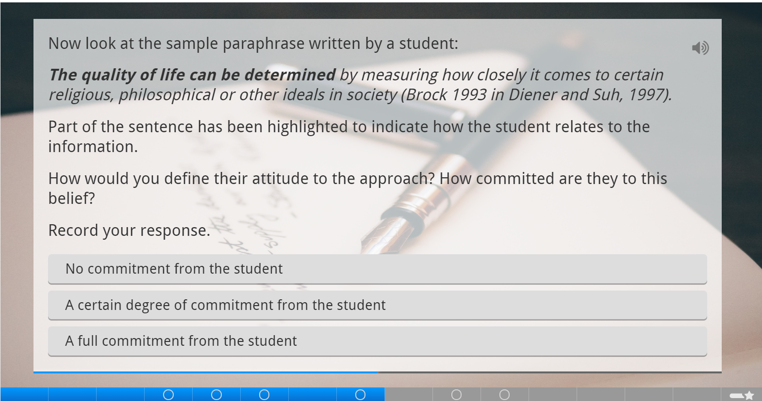

Slide 17
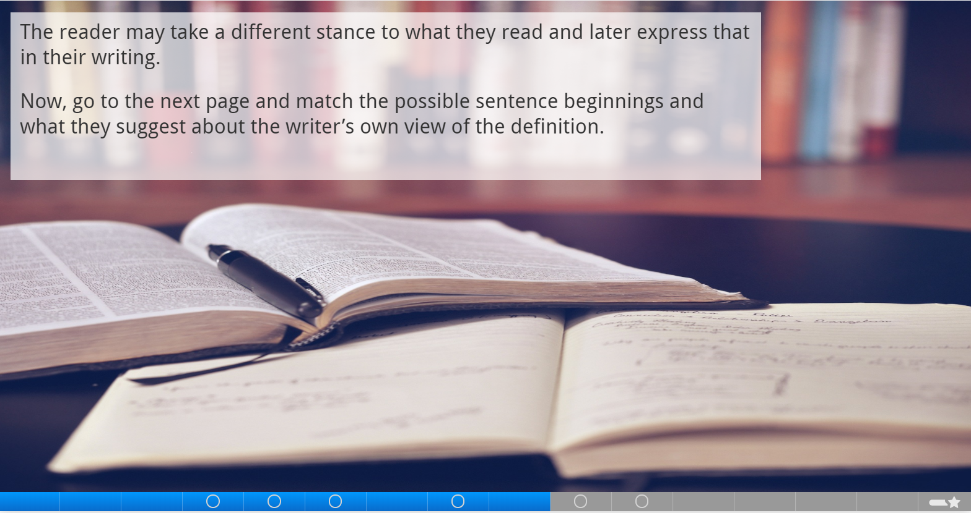

Slide 18
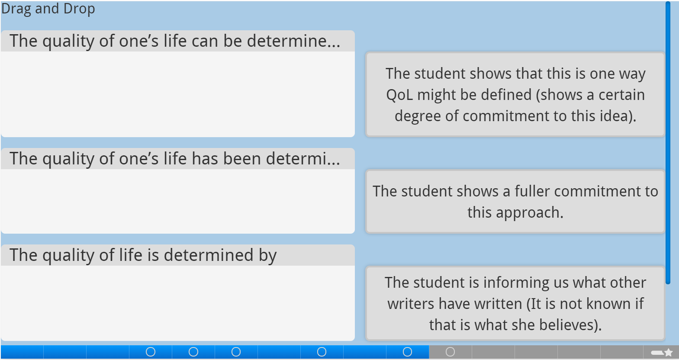

Slide 19
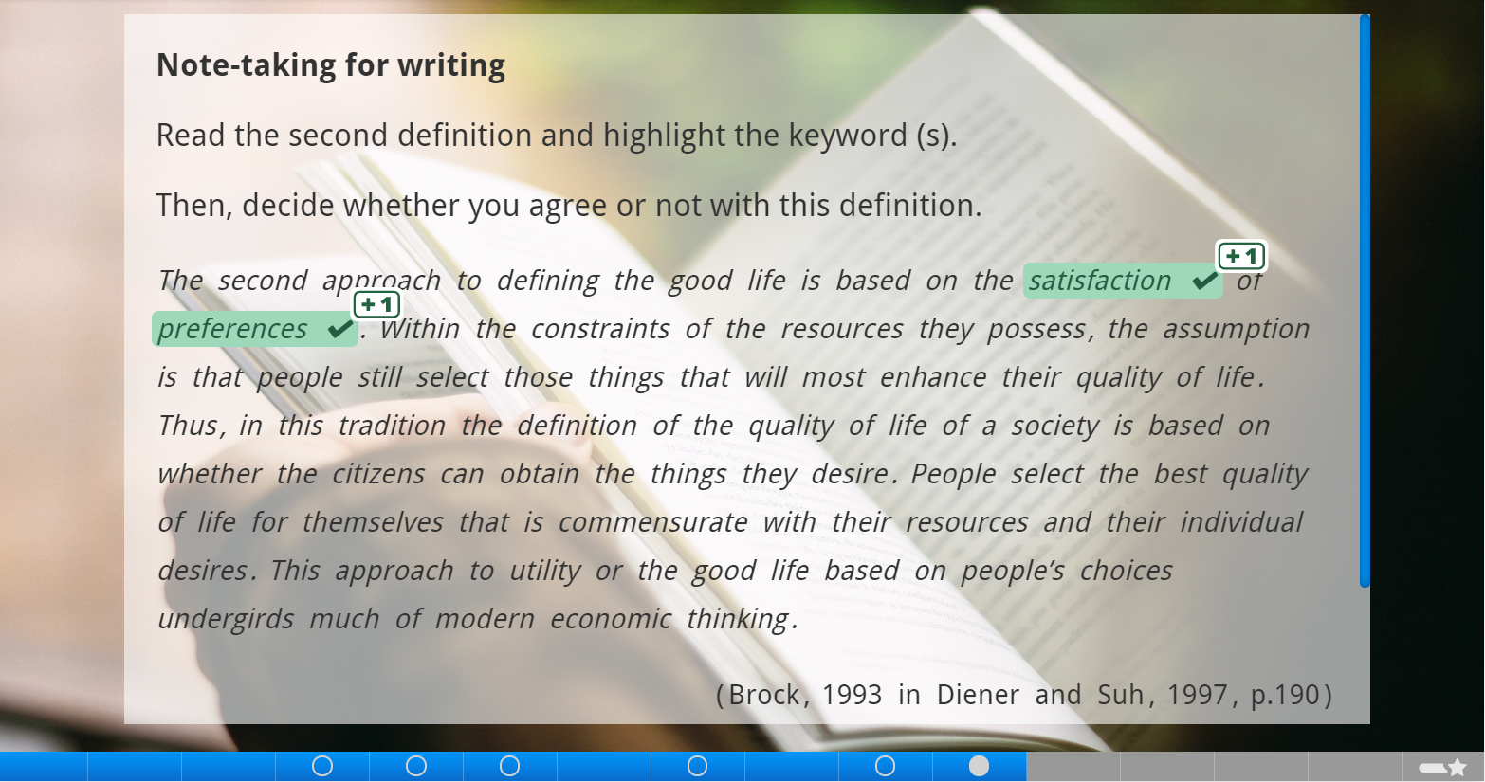

Slide 20
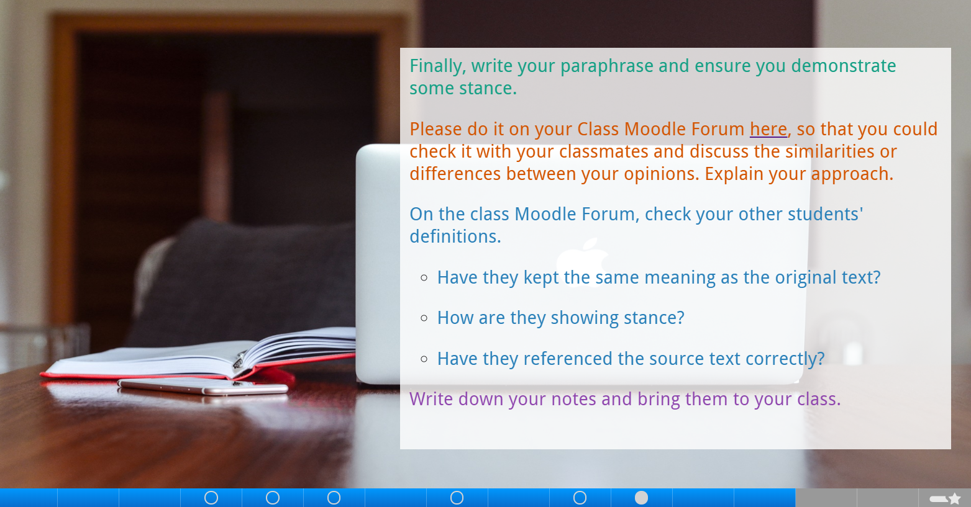
This is linked to the class Moodle Discussion Forum

Slide 21
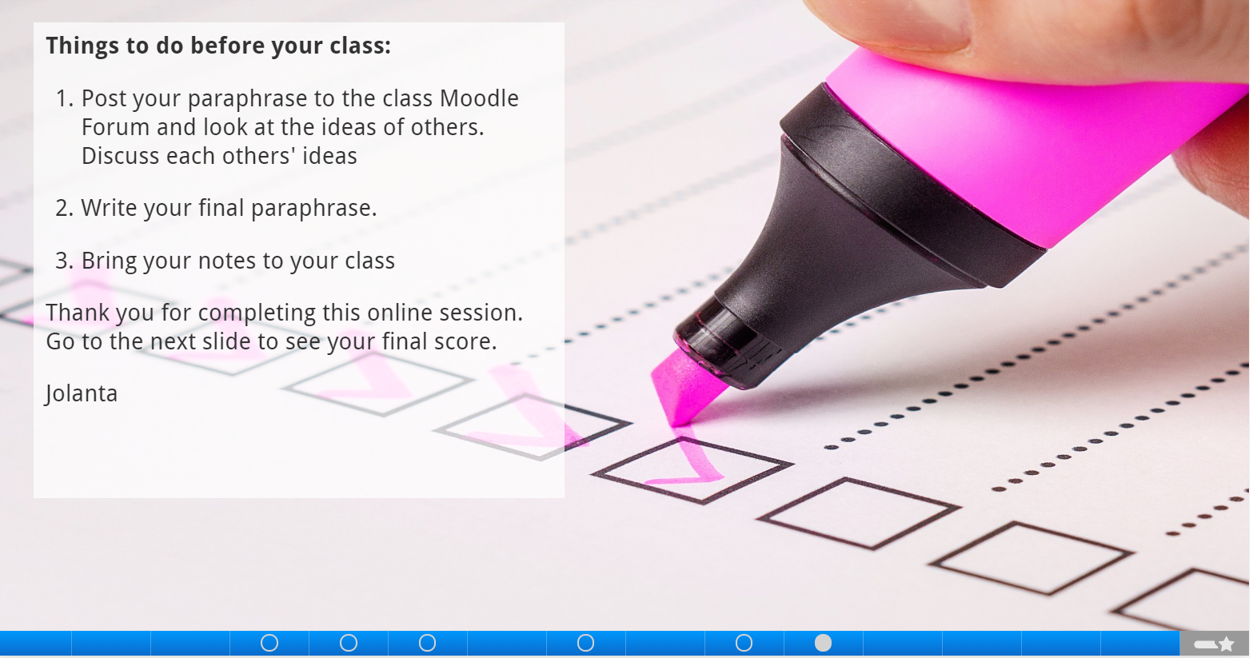

Slide 22
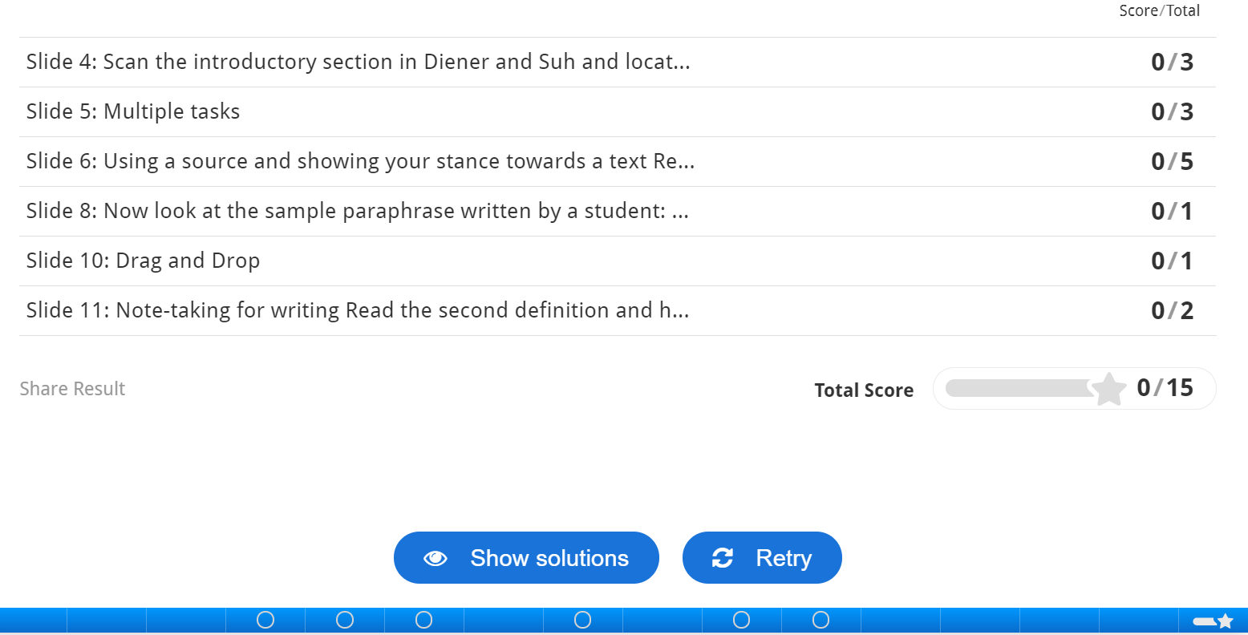

Slide 23
Student feedback
90% agreed that the purpose of the online session was clear.
90% agreed that the online content was easy to use.
90% agreed that the online session helped them to prepare for their class.
90% would like to do more online sessions like this in the future.
80% enjoyed the online session.
60% agreed that the activities helped them to develop their academic skills.

Slide 24

Student feedback (students’ comments)
There could be more interactive presentations on the internet. We have done one, which was very useful for me.
…because we were fond of the interactive homework on the internet, which you made, you might think about doing more interactive work online.
It would be maybe worth to try to do it
[course presentation] with time limit.

Slide 25
Evaluation
The technology gives users autonomy.
Its Interactive content can appeal to students.
Students can work both individually and collaboratively (e.g., on Moodle Forums).
It promotes the student-centred learning approach to teaching.
Students can receive immediate feedback after completing the online tasks.

Slide 26
Problems/Limitations
Teacher cannot see which students completed the task at home.
Students scores are not visible to the teacher.
There is no time limit for completing the tasks.
Students who struggle with academic coursework may find it difficult to complete some/all the tasks.
Students who fail to do their homework prior the session, may not be able to actively participate in the session.

Slide 27
References
Higher Education Academy, 2017. Flipped Learning [online]. Available at: https://www.heacademy.ac.uk/knowledge-hub/flipped-learning-0. [Accessed, 9 November 2018].
Nottingham Trent University, 2013. Centre for Academic Development and Quality Guide: The Flipped Classroom [online]. Available at: https://www4.ntu.ac.uk/adq/document_uploads/teaching/154084.pdf. [Accessed, 9 November 2018].
Pechenkina E., 2017. Flipping diverse classrooms: Instructor experiences and perceptions. 'Me, Us, IT!', Proceedings of the 34th International Conference on Innovation, Practice and Research in the Use of Educational Technologies in Tertiary Education (ASCILITE 2017), University of Southern Queensland, Toowoomba, Queensland, Australia, 4-6 December 2015. [Online] Available at: https://researchbank.swinburne.edu.au/file/4d316486-0c6f-4e89-9917-7e36d6a42f5f/1/2017-pechenkina-flipping_diverse_classrooms.pdf [Accessed, 1 April 2019].
The University of Texas at Austin, 2019. Flipped Classroom. Faculty Innovation Center. [Online] Available at: https://facultyinnovate.utexas.edu/flipped-classroom [Accessed, 2 April 2019].

Slide 28
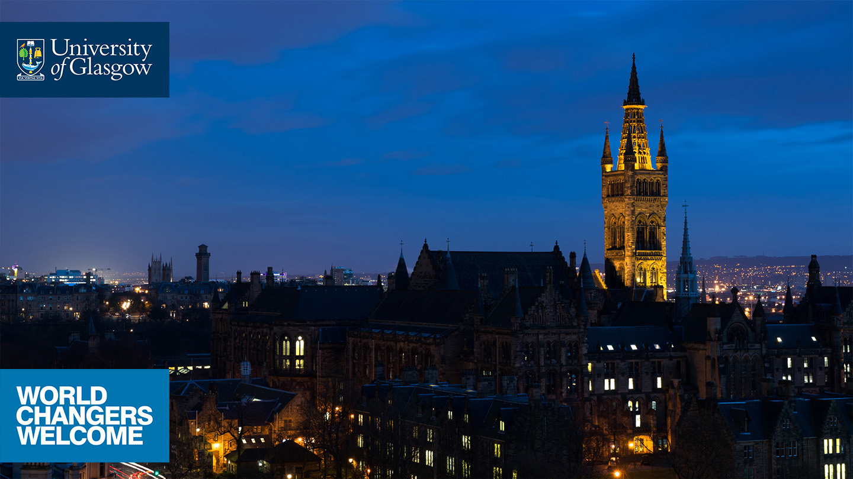







Thank you
jolanta.hudson@glasgow.ac.uk
English for Academic Study
School of Modern Languages and Cultures
/glasgowuniversity
@UofGlasgow
@UofGlasgow
UofGlasgow
Search: University of Glasgow

