Slide 1
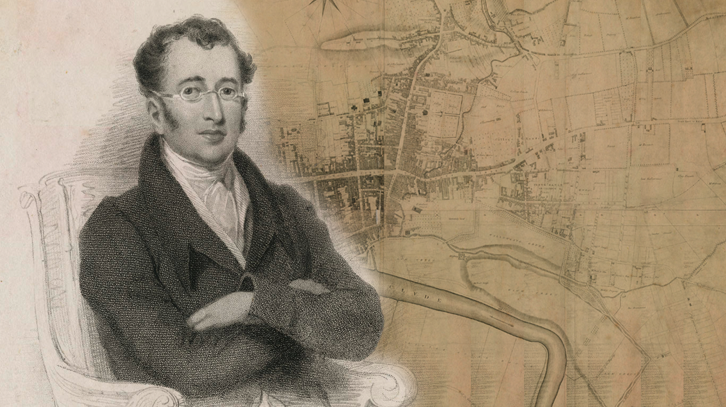
John Galt & Glasgow
Dr Craig Lamont
24 March 2018

Slide 2
John Galt & Glasgow
Timeline of places (with thanks to Ian McGhee)
Born 2 May 1779, Irvine
1789, moves to Greenock
1804, moves to London
1809, travels the Mediterranean
1811, returns to London
1818, moves to Greenock
1819, returns to London
1823, moves to Edinburgh
1825, travels to Canada
1826-29, travels North America, establishes new towns in Canada
1829, returns to London, short spell in King’s Bench Prison (debt)
1834, retires to Greenock, where he dies on 11 April 1839.

Slide 3
John Galt & Glasgow
Timeline of key works
Born 2 May 1779, Irvine
1789, moves to Greenock
1804, moves to London
1809, travels the Mediterranean
1811, returns to London
1818, moves to Greenock
1819, returns to London
1823, moves to Edinburgh
1825, travels to Canada
1826-29, travels North America
1829, returns to London
1834, retires to Greenock
The Ayrshire Legatees (1820-1)
Annals of the Parish (1821)
Sir Andrew Wylie (1822)
The Provost (1822)
The Entail (1822)
Ringan Gilhaize (1823)
Lawrie Todd (1830)
Life of Byron (1830)
Bogle Corbet (1831)

Slide 4
John Galt & Glasgow
Timeline of key works
Born 2 May 1779, Irvine
1789, moves to Greenock
1804, moves to London
1809, travels the Mediterranean
1811, returns to London
1818, moves to Greenock
1819, returns to London
1823, moves to Edinburgh
1825, travels to Canada
1826-29, travels North America
1829, returns to London
1834, retires to Greenock
The Ayrshire Legatees (1820-1)
Annals of the Parish (1821)
Sir Andrew Wylie (1822)
The Provost (1822)
The Entail (1822)
Ringan Gilhaize (1823)
Lawrie Todd (1830)
Life of Byron (1830)
Bogle Corbet (1831)

Slide 5
John Galt & Glasgow
Timeline of key works
Born 2 May 1779, Irvine
1789, moves to Greenock
1804, moves to London
1809, travels the Mediterranean
1811, returns to London
1818, moves to Greenock
1819, returns to London
1823, moves to Edinburgh
1825, travels to Canada
1826-29, travels North America
1829, returns to London
1834, retires to Greenock
The Ayrshire Legatees (1820-1)
Annals of the Parish (1821)
Sir Andrew Wylie (1822)
The Provost (1822)
The Entail (1822)
Ringan Gilhaize (1823)
Lawrie Todd (1830)
Life of Byron (1830)
Bogle Corbet (1831)

Slide 6
Annals of the Parish (1821)
The spectre of Glasgow:
“It is the Clyde’s Virginia trade that brings the first luxuries… It is the burgeoning city that creates a market for the second Mrs Balwhidder’s lucrative commerce in butter and cheese, and Glasgow is where Balwhidder’s son becomes a flourishing merchant… The new toll road to Glasgow… opens up the parish to new fashions, new ideas and the newspapers brought by the Glasgow carrier. It is Glasgow money (presumably the profits of the sugar and tobacco trade) that establishes a cotton-mill, with its politicised weavers, a bookshop and a sprawling new settlement.” (L. McIlvanney, 2012)
The weaving metaphor:
Following the new cotton mill [1808], Balwhidder says: “we had intromitted so much with concerns of trade, that we were become a part of the great web of commercial reciprocities, and felt in our corner and extremity, every touch or stir that was made on any part of the texture.” (Annals)

Slide 7
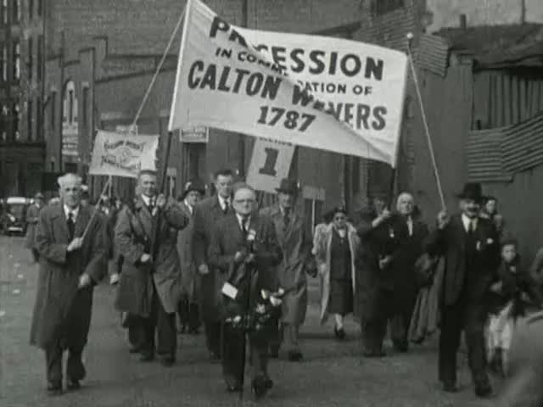
Annals of the Parish (1821)
The weaving metaphor (origin):
In The Ayrshire Legatees, Zachariah Pringle says: “at Greenock I saw nothing but shipping and building; at Glasgow, streets spreading as if they were one of the branches of cotton spinning.”
Political context:
“The folk belonging to the cotton-mill, and the muslin-weavers in Cayenneville, were afflicted with the itch of jacobinism, but those of the village were staunch and true to king and country.” Annals
In Bogle Corbet (1831), the restless artisans…
Glasgow Trades Council commemorating the martyrdom of the Calton weavers (1957)

Slide 8
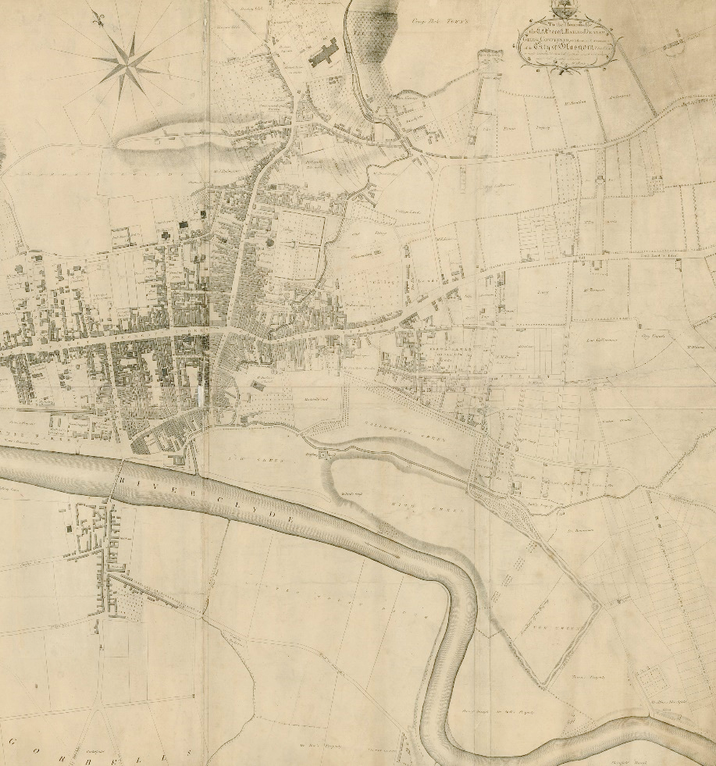
Annals of the Parish (1821)
Not just the Glasgow ‘effect’ on the rural parish, but the built environment of the city via:
‘The Black Boy’ Inn
‘The Cross-Keys’ Inn
The Trongate
The Gallowgate
The College (general buildings)
Divinity Hall (College)
Cathedral (inferred via General Assembly)
The Gorbals
The Glasgow Market
‘the creditable town of’ Port-Glasgow

Slide 9
The Steam Boat (1822)
Sentimentality…
“I began to feel an onset to a new emotion working within me... and in the end came to a head, in my going forth a second time from the obscurity of the Salt-market, and the manufacturing smokes and smells of Glasgow, to enjoy the hilarity of the sparkling waters of the summer sea, and the blitheness of the hills and of all living things.”
… giving way to irritation:
“Although Glasgow is surely a large and populace place, it must be allowed that it is but a narrow sphere for observation…”
“that dinging, and bumping, and driving, that happens in the Trongate, especially on a Wednesday, enough to make the soberest man wud at the misleart stupidity of the folk…”

Slide 10
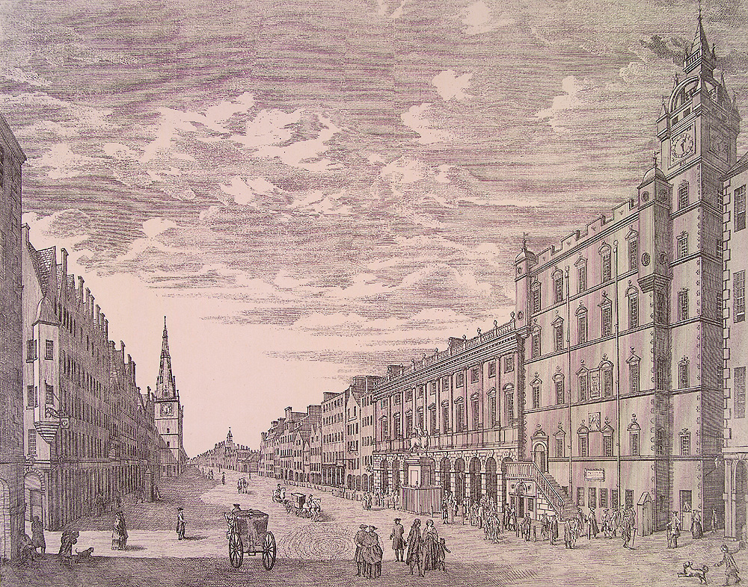
Engraving of Trongate (1770) – Robert Paul

Slide 11
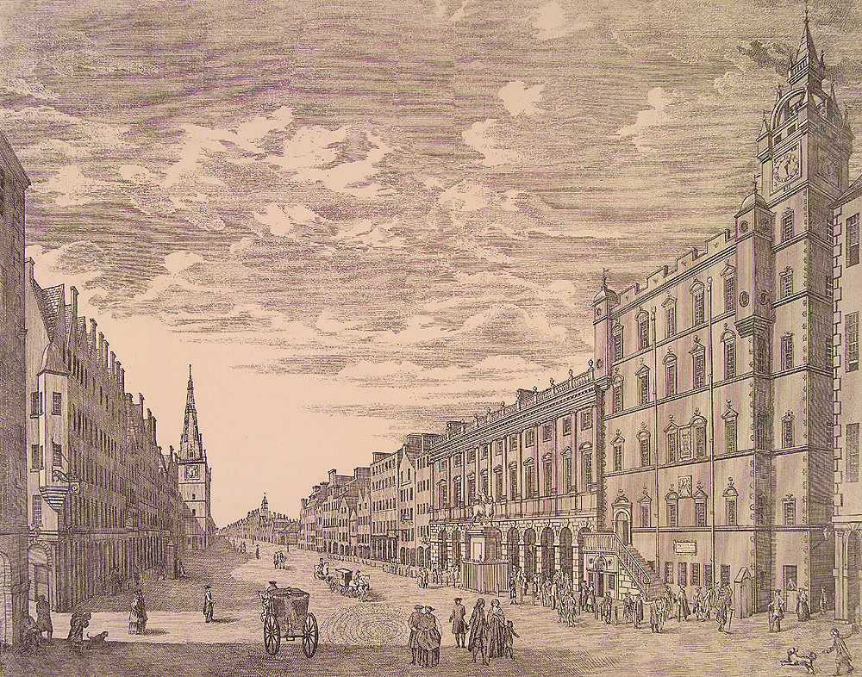
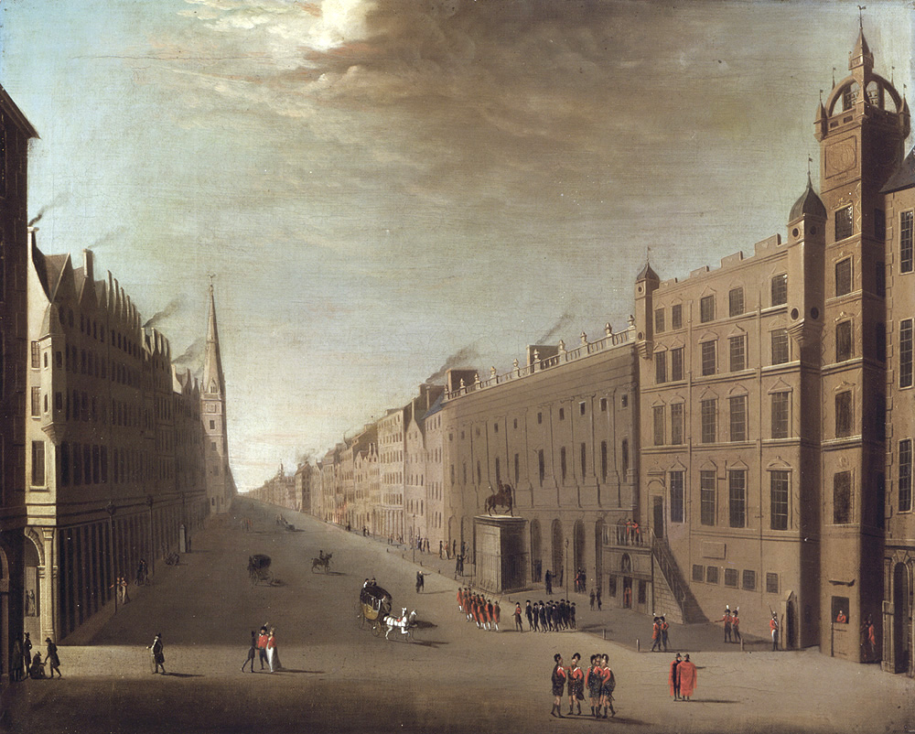
An oil painting of the Trongate c 1770-1790 –artist unknown

Slide 12
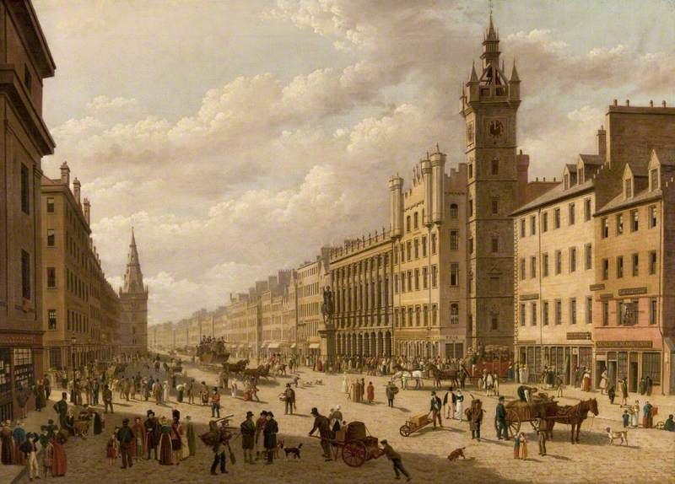
Old Glasgow Cross
or The Trongate (1826)
- John Knox (1778-1845)

Slide 13
The Entail (1822)
Galt’s ‘central’ Glasgow novel?
Shifting the reader’s understanding of the Darien scheme to Glasgow:
“Claud Walkinshaw was the sole surviving male heir of the Walkinshaws of Kittlestonheugh. His grandfather, the last Laird of the line, deluded by the golden visions that allured so many of the Scottish gentry to embark their fortunes in the Darien Expedition, sent his only son, the father of Claud, in one of the ships fitted out at Cartsdyke, and with him an adventure in which he had staked more than the whole value of his estate.”
c. 120 Glasgow merchants subscribed to the scheme.
Glasgow businessmen & citizens began to believe in the idea of their city becoming HQ for The Company of Scotland Trading to Africa and the Indies.

Slide 14
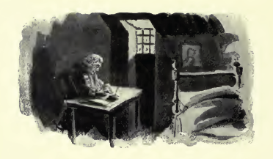
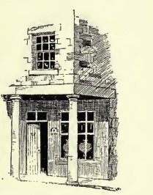
The Entail (1822)
Painting the earlier days of Glasgow’s prosperity:
“Claud returned to Glasgow with five hundred pounds above the world, and settled himself as a cloth-merchant, in a shop under the piazza of a house which occupied part of the ground where the Exchange now stands.”
Daniel Defoe: “The houses are all of stone, and generally equal and uniform in height, as well as in front; the lower story generally stands on vast square dorick columns, not round pillars, and arches between give passage into the shops, adding to the strength as well as beauty of the building; in a word, ’tis the cleanest and beautifullest, and best built city in Britain, London excepted.”
From Literary Landmarks of Glasgow (1898)

Slide 15
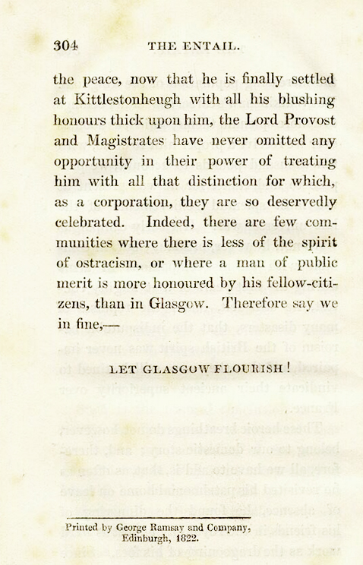
The Entail (1822)
Published months after George IV’s visit to Edinburgh
Entail dedicated ‘To the King’
Glasgow referred to as the ‘royal city’
Stoking the old rivalry between the cities.

Slide 16
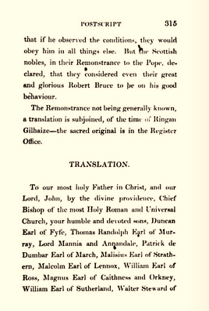
Ringan Gilhaize (1823)
Declaration of Arbroath
‘Rewriting’ Scott’s version [?]
Glasgow localised again:
The Cathedral: General Assembly of 1638
“the city of Glasgow, with her goodly array of many towers, glittering in the morning beams, lay in sight some few miles off on the north.”
The ‘Glasgow School’ w/ Michael Scott, Thomas Hamilton, Walter Scott

Slide 17
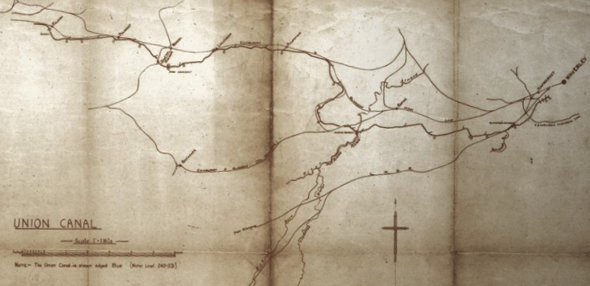
Galt & the Clyde
References to the rich tradition of poetry
Plans for retirement to the ‘Romantic’ spot
His debt to Glasgow & merchant life
Lobbying for the Glasgow-Edinburgh Union Canal in Westminster.
Plans to improve & dam the Clyde

Slide 18
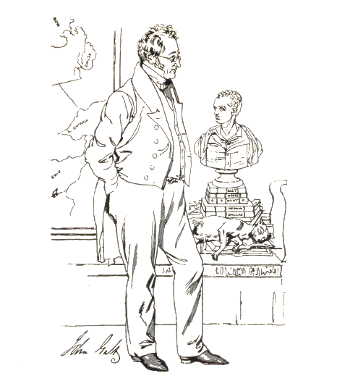
Galt & North America
Lawrie Todd (1830), a tale of the founding of Rochester, New York, following time abroad.
More local markers: buildings, inns, etc.
The sense of awe
The most quotable… ‘Greenock, the most enlightened community in the West of Scotland, scarcely excepting even that of Port Glasgow; so justly, for its taste in the fine arts, denominated the Florence of the West.’

Slide 19
Galt & North America
Bogle Corbet (1831) [original]
Starts out very much as a Glasgow novel in the mould of the earlier works.
Echoes The Entail: ‘Let Glasgow Flourish by the weaving of cotton.’
The old world vs. the new (cf. Henry Graham)
Galt: ‘I considered the discovery of America as equivalent to the creation of another continent, purposely to relieve the oppressed of the old, and to afford an asylum to those who were inclined to the moderation of that way of life…’

Slide 20
Galt & North America
Bogle Corbet (1831) [original]
The bustle of Glasgow’s streets
Topographical descriptions of the city
The unrest of the weavers
Commentary on slavery
The confluence of speech:
the ‘almost English tongue of Mr. Macindoe’ from his years in the West Indies; the English-American ‘decisive and energetic vernacular’ of Dr. Leach; and the ‘genuine Trongate’ of Mr. Aird.

Slide 21
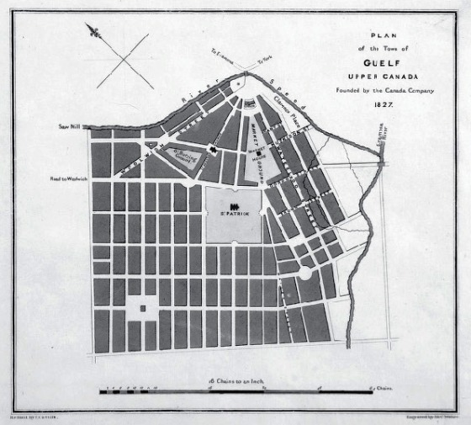
Galt & North America
The founding of Guelph fictionalised in Bogle Corbet v.III:
“I left the name to be given by the settlers themselves, and in the course of the day heard that they had fixed on one; both appropriate, as it referred to themselves, and agreeable to me, as applied to a new place. In Glasgow there is an old well-known street called “The Stockwell,” and… Several of the Glasgow men being artisans and crafts’ men, Stockwell was intended chiefly for them, and those who might come after of the same kind.”

