Slide 1





Research Launch
Purpose in business
Empowering employees and enhancing productivity
Notes:
1

Slide 2
Agenda
Welcome
Introduction to the project
Now is the Time for Purpose
Purpose-led business models, productivity and meaningful work
Purposeful Businesses
New ways of thinking about productivity
Q&A & Group discussion
Close
Notes:
2

Slide 3
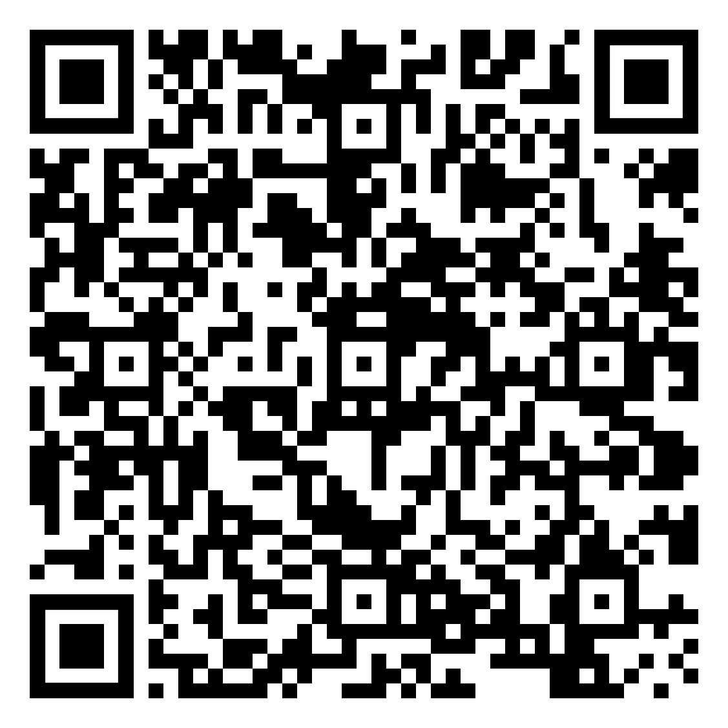
Welcome
Project and collaborators
Purpose in business: empowering employees and enhancing productivity
Funded by ESRC and TPI and runs from March 2024 to February 2025
Collaborative: University of Glasgow, Scotland Productivity Forum, Prosper and Peer works as well as with our stakeholder group and the business and policy communities.
Aim: understand key aspects of what will empower employees in different types of business to influence or drive purpose and identify how businesses can support employee-driven purpose.
Notes:
3

Slide 4
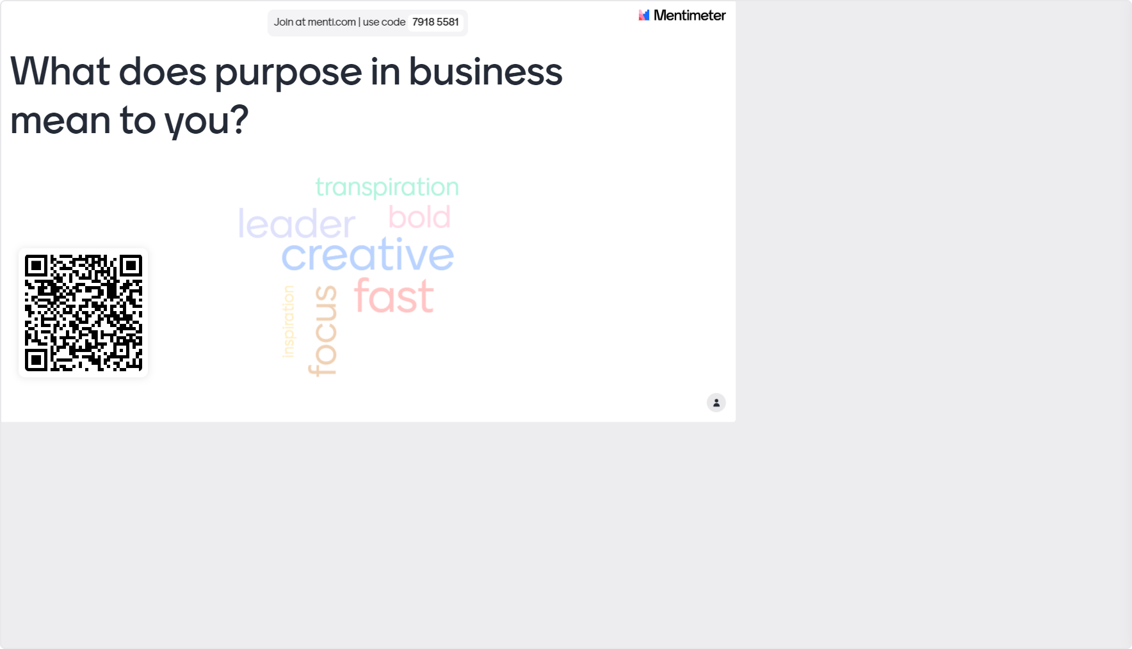
Notes:
4

Slide 5
Prof Bridgette Wessels University of Glasgow
The Productivity Institute
Introduction to the Project
Notes:
5

Slide 6
Introduction to the project
There is growing interest from business and government in the potential of purpose in business to improve productivity. Although there are opportunities for business purpose to enhance productivity, there are, also several challenges, one of which is how to empower employees to drive purpose. Little is known about whether and how ‘purpose’ features in both employee and business perspectives.
Two aspects to the challenge: (1) understand employee perspectives about purpose, what they feel would empower them to drive purpose; and (2) identify what changes business need to undertake to support employees to drive purpose.
Central Question: In what ways can businesses and employees enact purpose to enhance productivity?
Notes:
6

Slide 7
Introduction to the project
Subsidiary questions: In what ways can employees be empowered to drive purpose? What can businesses do to empower purpose-driven employees?
Methods: interviews with employees and managers in five case study businesses, employee and manager workshops, stakeholder workshops and secondary analysis of case study data of ‘Now is the Time for Purpose’ report.
Confirmed business case study partners: SSE Transmission; ACS Clothing, Jerba Campervan, The Wise Group
Strong collaborative and business engagement approach, our stakeholder group and the wider business and policy community.
Notes:
7

Slide 8
Gareth Williams
Prosper
Now is the Time for Purpose
Notes:
8

Slide 9
Dr Anna Clover
University of Glasgow
Purpose-led business models, productivity and meaningful work
Notes:
9

Slide 10

Purpose-led business models, productivity and meaningful work
Dr Anna Clover
Research Associate
Sociology Department
University of Glasgow

Slide 11
Purpose-led business models
Growing governmental, academic and practical interest in the potential for purpose-driven businesses to implement positive social and environmental change.
'Businesses have to recognise that they exist at the pleasure of society, not the other way around. They, therefore, need to be net contributors to society.' (Barclays CEO/chairman Antony Jenkins, in White et al., 2017).
Requires radical re-thinking as to the purpose of businesses within society – to strive beyond profit-making towards goals that centre societal and planetary welfare (Brosch, 2023).
Organisations must consider how both their external actions and internal practices are informed by a demonstrable purpose that is ethically informed (George et al., 2023).

Slide 12
Purpose in action
What does purpose mean in action? – Development of values and ideals that make sense for a specific organisation. Should be the touchstone for all decisions, permeate all organisational levels (White et al., 2016).
Requires structural changes – organisations must consider how key decision are made and who is included, appropriate training for managers and employeees, how actions based on purpose rather than profit are incentivised at all levels, how achieving purpose-informed goals will be recognised and measured within organisation (George et al., 2023, Villela et al., 2019, Steger, 2016, White et al., 2016) .

Slide 13
Benefits and challenges
Benefits: reputation of brand, greater customer satisfaction and loyalty, recruitment and retention of employees, increased productivity and wider societal and environmental benefits (Johnson et al., 2019, Steger, 2016, van Riel, 2012, von Ahsen and Gauch, 2021).
Key challenge: 'Employee engagement is central in putting purpose into action' (George et al., 2023:1848). Coherency between workers and employer's views of purpose – purpose must be meaningful to workers, value of workers labour to company's purpose must be clear (von Ahsen and Gauch, 2021).

Slide 14
Meaningful work
Current research tends to centre on either objective (e.g. workplace structures, rules, policies) or subjective (e.g. individual's values, feelings, ambitions) contributors to workers' experiences of meaningful work (Laaser and Karlsson, 2021, Laaser, 2022).
For a full picture, need to understand how objective and subjective elements interact, within both formal and informal workplace practices - 'in relation to the interplay of workplace, managerial, societal and individual relations' (Laaser and Karlsson (2021:798). How such processes interact and contribute to workers experiences of autonomy, recognition and dignity (Laaser and Bolton, 2022).
Approach can strengthen alignment of employers and employees understanding of purpose-led work.

Slide 15
References:
Brosch, N. 2023. Corporate purpose: from a ‘Tower of Babel’ phenomenon towards construct clarity. Journal of Business Economics 93.
George, G., Haas, M., McGahan, A., Schillebeeckx, S. and Tracey, P. 2023. Purpose in the For-Profit Firm: A Review and Framework for Management Research. Journal of Management 49(6).
Johnson, S., Spher, M., Rowan, R., Berghoff, J., Kelley, J. and Sisodia, R. [no date]. Editor’s Desk: The Potential and Promise of Purpose-Driven Organizations. American Journal of Health Promotion 33(6).
Laaser, K. and Bolton, S. 2022. Absolute autonomy, respectful recognition and derived dignity: Towards a typology of meaningful work. International Journal of Management Reviews, 22(3).
Laaser, K. 2022. Meaningful Work and Sociology: An Introduction to This Themed Issue. Work, Employment and Society 36(5).
Laaser, K. and Karlsson, J. 2021. Towards a Sociology of Meaningful Work. Work, Employment and Society 36(5).
Lyon, F., Stubbs, W., Dahlmann, F. and Edwards, M. 2024. From “business as usual ”to sustainable“ purpose-driven business”: Challenges facing the purpose ecosystem in the United Kingdom and Australia. Business and Society Review.
Steger, M. 2016. Creating Meaning and Purpose at Work. In: The Wiley Blackwell Handbook of the Psychology of Positivity and Strengths‐Based Approaches at Work Individual Approaches to Positive Psychology at Work. John Wiley & Sons, Ltd.
van Riel, C.B.M. 2012. The Alignment Factor. 1st ed. Routledge.
Villela, M., Bulgacov, S. and Morgan, G. 2019. B Corp Certification and Its Impact on Organizations Over Time. Journal of Business Ethics 170, pp. 343–357.
von Ahsen, A. and Gauch, K. 2022. Opportunities and Challenges of Purpose‑Led Companies: An Empirical Study Through Expert Interviews. Corporate Reputation Review 25, pp. 198–211.
White, A., Yakis-Douglas, Basak, Helanummi-Cole, H. and Ventresca, M. 2016. Purpose-Led Organization: “Saint Antony” Reflects on the Idea of Organizational Purpose, in Principle and Practice. Journal of Management Inquiry 26(1), pp. 101–107.

Slide 16
Jackie Brierton
GrowBiz
Purposeful Businesses
Notes:
16

Slide 17
Eleonora Vanello
Peer Works - Prosper
New Ways of Thinking about Productivity Productivity
Notes:
17

Slide 18
Total output = Labor Productivity
Total input
Notes:
18

Slide 19
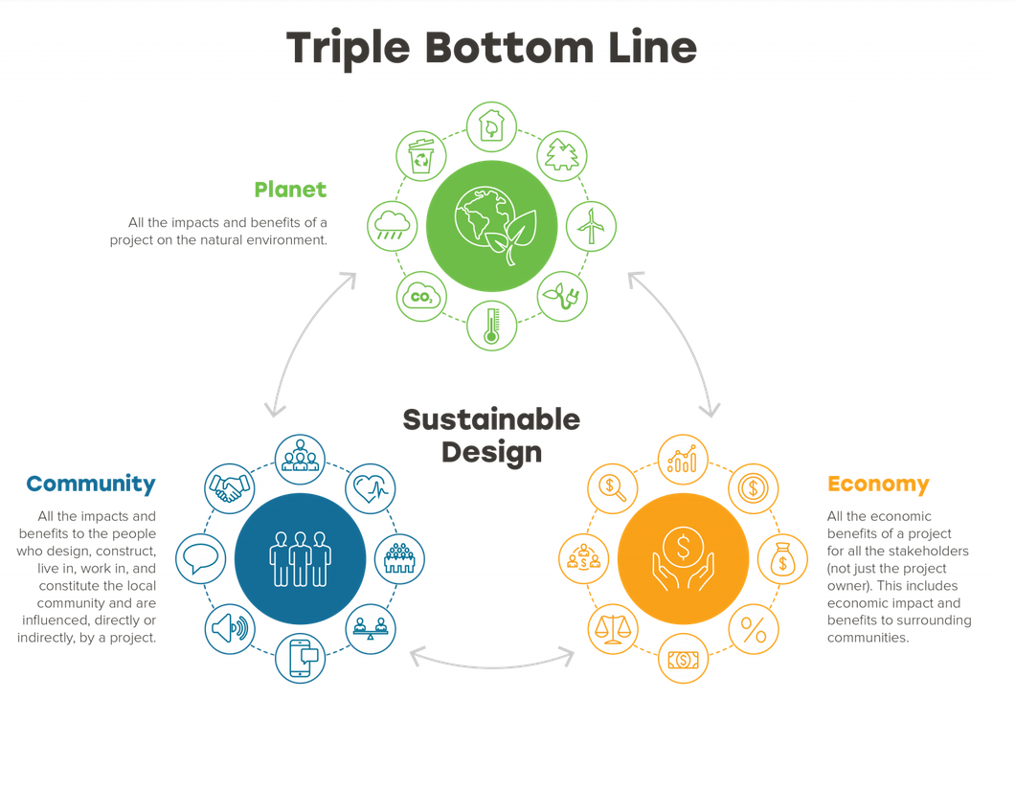
Source: Making the Business Case for Triple Bottom Line and ESG, Jessica Glorius-Dangelo, https://designwithma.com/
Notes:
19

Slide 20
Q&A
Group Discussion
Notes:
20

Slide 21
Questions
In what ways do you think purpose-driven businesses can enhance productivity compared to traditional profit-focused models?
How can businesses balance the need for profitability with the broader goals of social and environmental responsibility?
What examples have you seen of successful purpose-led businesses? What made them successful? What can we learn from these examples?
In your opinion, what can the Scottish government do to support and incentivise businesses to adopt purpose-driven practices?
Notes:
21

Slide 22
Research Launch
Purpose in business
Empowering employees and enhancing productivity
Notes:
22

