Slide 1


NSS Promotion Advice
Confidential for University of Glasgow Staff Use Only

Slide 2

What is the NSS?
  The National Student Survey (NSS), is for UG students in their final year and is run by Ipsos MORI
  It is an opportunity for students to give feedback on what they liked about their experience at the University of Glasgow and what could be improved
  It will open on 5th February and closes at the end of April
  It is important to help the University enhance the student experience and learning

Slide 3
Please make yourself familiar with
  The NSS Staff web pages:
  www.gla.ac.uk/planning/surveys/nss/staff/
  The NSS Student web pages:
  glasgow.ac.uk/nss/
  The Ipsos MORI NSS web pages (particularly the FAQs):
  thestudentsurvey.com

Slide 4
Key Points for Staff
  Reducing emails to students
  We would recommend on holding back on emailing students unless it is part of an email which is going out anyway.
  - they receive ~ 12 emails from the Survey Team and Ipsos MORI.
  We will assess response rates as the survey proceeds
  For 2024, we are recommending that you only mention NSS a maximum of 3 times between Feb-Apr via whatever communication means you have e.g.:
You are emailing the students about something else
    Moodle
    Zoom/Teams – whether lectures, tutorials or general catchups

Slide 5
Key Points for Staff
  The NSS Timeline is a useful guide on what happens each week
  The Help Card on Sharing of Response Rates is important – we cannot share response rates outside the university
  The NSS Questionnaire shows what questions the students are asked

Slide 6
Key Points for Staff
  You Said, We Did! highlights the changes the university has made as a result of student feedback from surveys: www.gla.ac.uk/students/feedback/changes/
  We will make students aware that good NSS results do not affect fees
  If a student completes the survey they will be entered into a prize draw for a top prize of £500 or five runners up prizes of £100
  Digital posters are available on the NSS staff website

Slide 7
What the Student Communications Team will be doing to promote the NSS
  The NSS Student web pages: glasgow.ac.uk/nss/
  You Said, We Did! promotion for students
  Screen NSS adverts (for any on-campus students)
  Twitter
  Facebook
  Yammer
  Communications Advice

Slide 8
What the UofG Survey Team (PIA) will be doing to promote NSS
  The NSS Staff web page: www.gla.ac.uk/planning/surveys/nss/staff/
  Emails to students are per the timeline on the staff web pages
  Regular response rates to staff as the survey progresses
  UofG Surveys Yammer for staff
  Advice for Staff or Students

Slide 9

What the SRC will be doing to promote the NSS
  The NSS Poster for digital display (for any on-campus students)
  Encouraging Students to participate
  Putting up NSS posters around campus

Slide 10
What we need you to do
  We normally ask lecturers to use video or PowerPoint before lectures
  Let students know that Ipsos MORI will keep emailing and phoning until students complete, so if they intend to complete the survey, sooner would be better
  Display digital posters where possible (for on-campus students)
  If a student wishes to opt out they can either do this via the NSS FAQ page (cumbersome) or by emailing us at UofG Surveys (planning-central-surveys@glasgow.ac.uk)
  Use local social media to promote the survey
Notes:
Ask them if there is anything else over and above these that they have done in the past

Slide 11
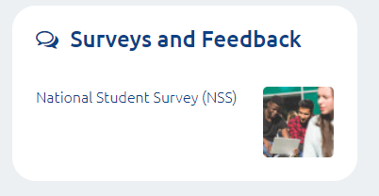
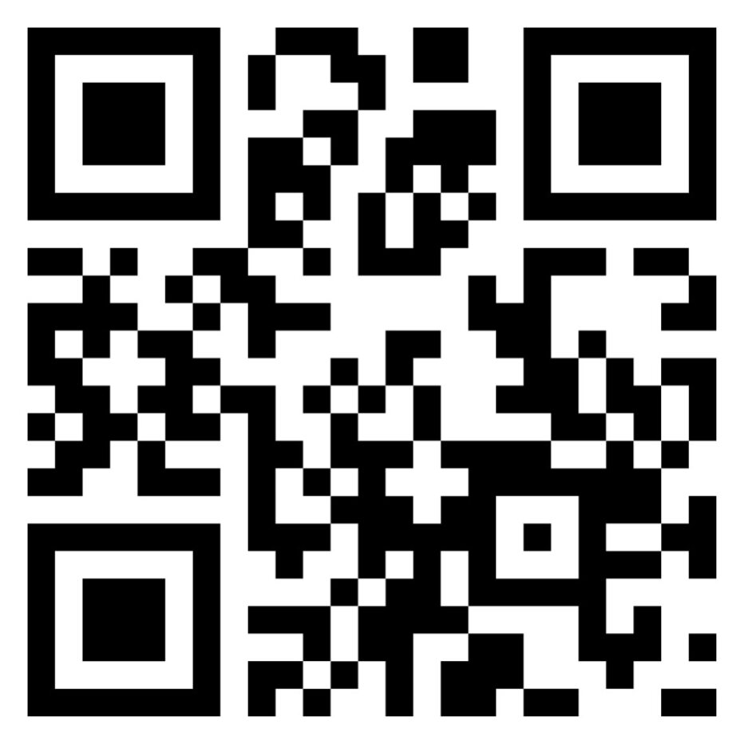
Students can complete the survey at
  The MyGlasgow Student link
  thestudentsurvey.com
  Over the phone when they are called
  Using the QR code:

Slide 12
Students can get help from
  thestudentsurvey.com – particularly the FAQs
  By emailing the UofG Survey Team at:
  UofGSurveys (planning-central-surveys@glasgow.ac.uk)
  By emailing Ipsos MORI at: thestudentsurvey@ipsos.com

Slide 13
Staff can get help from
  The UofG Survey Team or the Student Communications Team at:
  UofGSurveys (planning-central-surveys@glasgow.ac.uk)
  Jacqueline MacGowan - Jacqueline.MacGowan@glasgow.ac.uk
  Jacqueline Jack - Jacqueline.Jack@glasgow.ac.uk
  Yammer ‘UofG Surveys’ group

