Slide 1
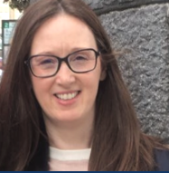
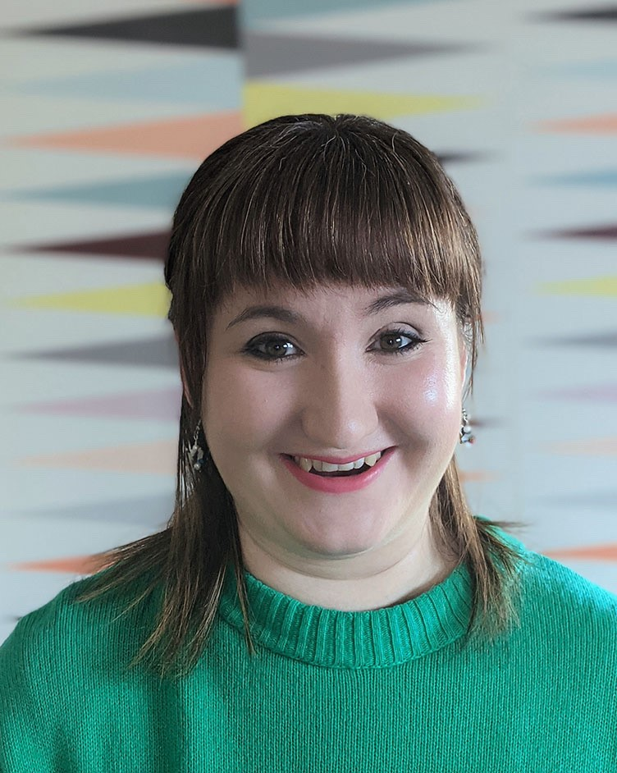
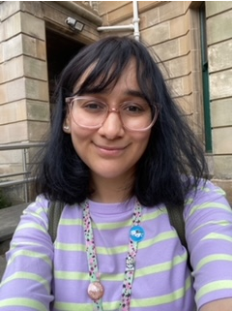
COLLEGE OF ARTS
Student Support Officers (SSOs)
ARLENE
CAT
RABAHA
Arlene is SSO team lead and born on the Saint Andrew’s Day. Can you guess her birthday?
Hint: Its on a Thursday this year!
Cat works in the SSO team part time & knows all about jewellery & metal design. Can you guess who made the earrings in the photo? Hint: Its not who you think it is!
Rabaha works in the SSO team part time & loves reading& writing about children’s books. Can you guess the name of the bird in her pin badge?
Hint: Think publishers!
Notes:
Introduce selves/each other
Arlene is our team lead
We're SSOs in College of Arts – here to help link you up with different sources of support across the uni while you're here
We're here to talk to you about anything that’s on your mind
Come and see us if you are overwhelmed
Please reach out to us throughout your time at University if you have any worries or concerns
Sometimes student come to us even if they don’t know what they need so don't be afraid to do that – that's also what we're here for.

Slide 2
HOW CAN SSOs SUPPORT THE STUDENT JOURNEY?
DISABILITY SERVICES
ACCOMODATION
HEALTH & WELLBEING
STUDY SUPPORT
CAREERS
PEER WELLBEING
FINANCIAL AID
We encourage & help our students in resolving any issue or difficulty they experience and signpost to specialist university services for further support.
Notes:
So, what does a Student Support Officer do?
It can be really overwhelming coming into university for the first time, and you may not be aware of all the support that is available to you. If you are ever in this situation, where you need support/information/guidance, your student support officer is your first port of call, as we have close relationships with different support services across the university and we can link you up with these – some of which, you may not have heard of.
We can also link you up with external services too, such as registration with GP services or the Student Representative Council.
For example, you might be having a problem with your accommodation, and we can help you make contact with the relevant people in accommodation services to help you.
Or you might be in financial difficulty, because let's face it, being at uni and managing money can be difficult, you could have a chat to us and we could link you up with the relevant service that could ease some of that pressure.
You might also be feeling homesick or lonely, because you're away from home for the first time, which is completely normal. Again, you can have a chat with us and we can look at the various services across the university that might help. The university has a brilliant peer wellbeing team for example, and they might be able to help you to feel less isolated.
There are some other examples on this slide – including the careers service, the counselling service, disability services, study support etc. And we can help link you up with these as well.
We don’t offer academic advice or support, but we work very closely with the arts advising team and the chief advisor of studies, both of whom can help you with any queries or concerns related to the academic side of things.
We would like to clarify here that, although we're not an emergency service and we're not mental health trained or a substitute for mental health support, we are approachable and we're here to listen and help you and we'll be part of getting you the right support that you need
.

Slide 3
HOW TO CONTACT SSOs:
OPERATING HOURS: Mon to Fri (9AM – 5PM)
EMAIL: arts-studentsupport@glasgow.ac.uk
PHONE: 0141 330 7624
Notes:
So where can you find us?
The best way to contact us is through the email address on screen or the phone number – which we would encourage you to jot down now.
We tend to be around campus and there should always be an SSO available Monday to Friday 9-5pm but be aware, we all work at different times, so it's usually best to send us an email and we'll get something arranged either online or in person
Thank you for your time, enjoy your time at university and we look forward to meeting some of you soon!

